Slide 1
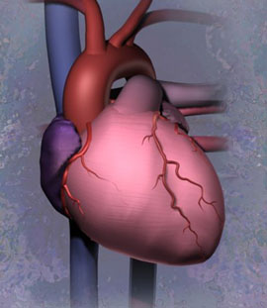
Cardiovascular System Anatomy of the Heart

Slide 2
The Cardiovascular system is comprised of the heart, blood vessels, & blood
The heart acts as a “pump”, creating pressure which causes blood to move through the blood vessels of the body, allowing O2 & nutrients to be distributed to, & wastes removed from, body tissues

Slide 3
Heart Anatomy Overview
Play Heart Anatomy video

Slide 4
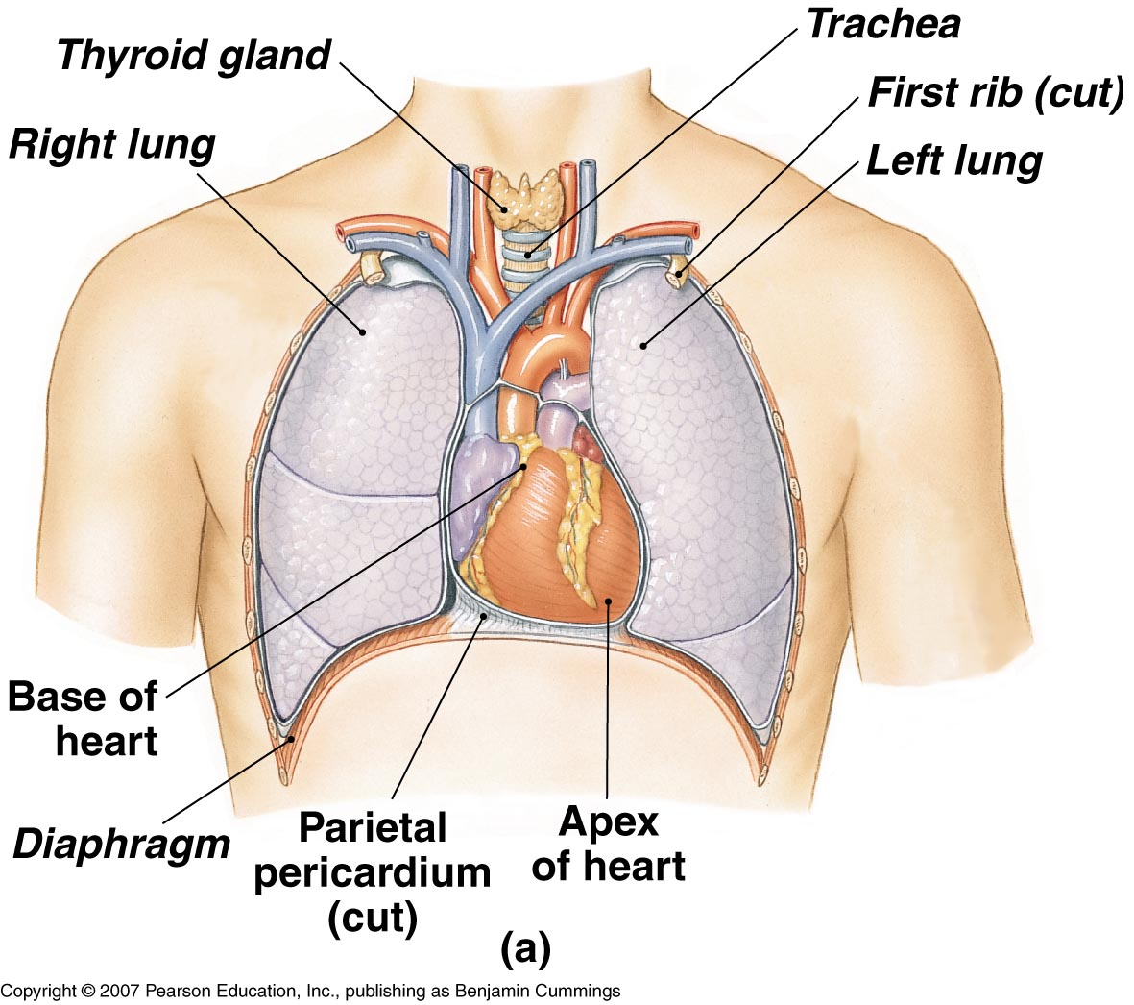
Anatomical Features of the Heart
The heart lies within the mediastinum of the thoracic cavity
Hollow muscular organ with four internal chambers
(2) atria (lt. atrium & rt. atrium)- receive blood from veins
(2) ventricles (lt. ventricle & rt. ventricle)- pump blood into arteries
Superior aspect of heart is the “base”, where the blood vessels attach; Inferior is the “apex”, which rests on the relaxed diaphragm

Slide 5
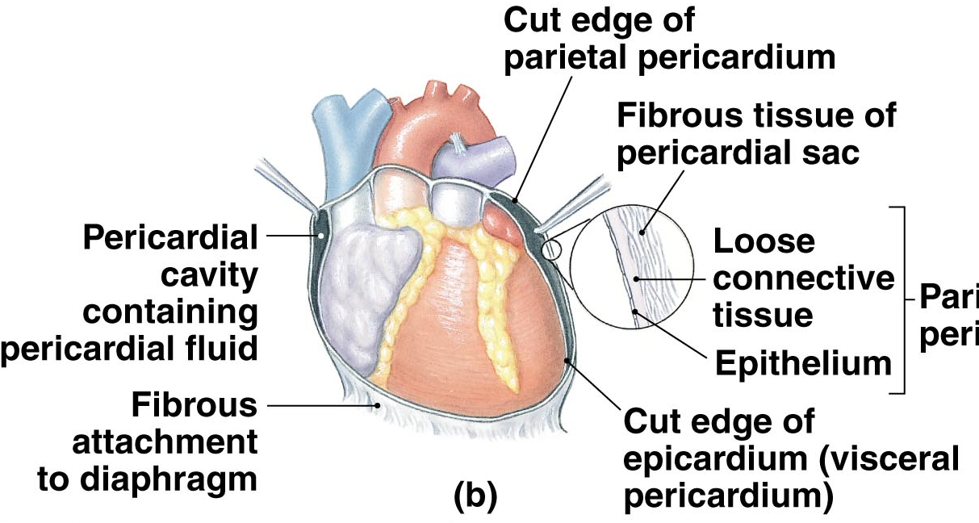
Pericardium
The heart lies enclosed within pericardial membranes
Fibrous pericardium (pericardial sac) – outer layer of dense CT that protects & anchors
Serous pericardium – double layered membrane with “pericardial fluid” between
Parietal pericardium – lines the pericardial sac
Visceral pericardium – covers the heart; also known as the “epicardium”
etal
cardium

Slide 6
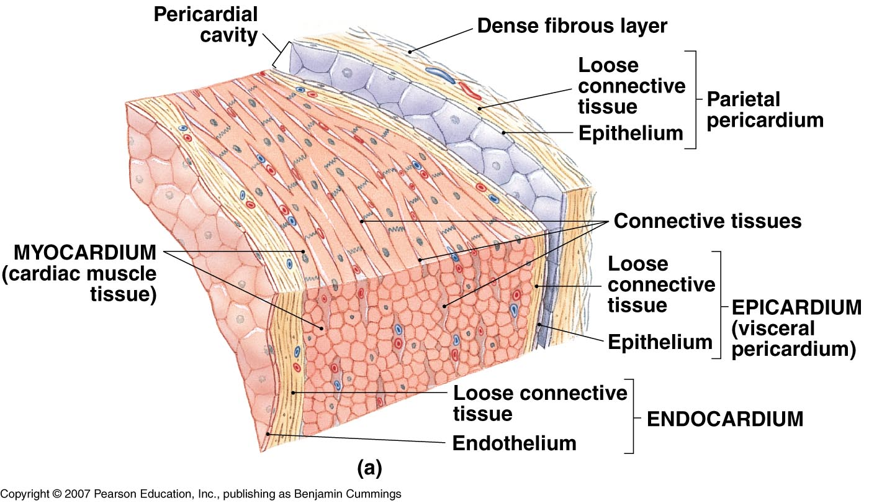
Layers of Heart Wall
Epicardium (a.k.a. visceral pericardium)
Myocardium
Endocardium

Slide 7
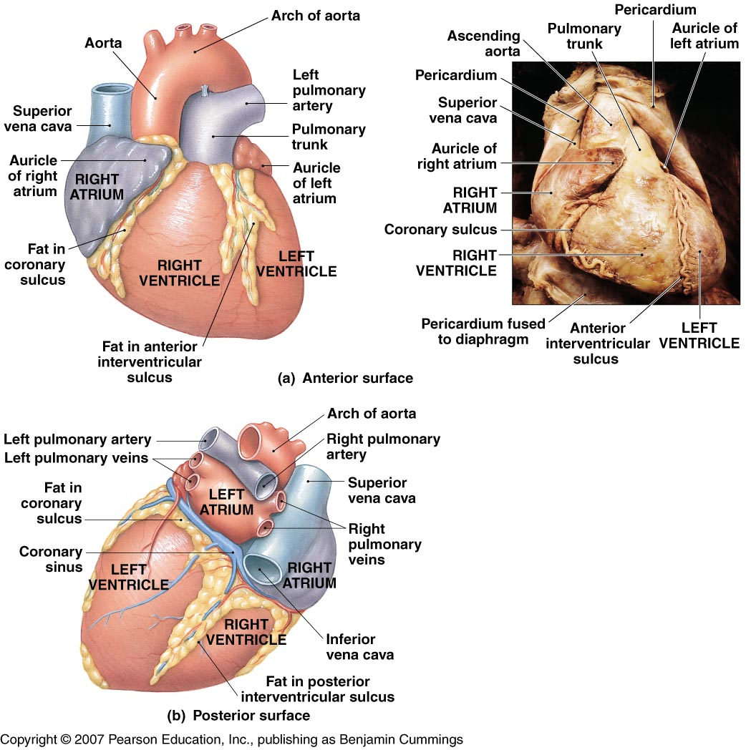
External Features
Auricles
Coronary sulcus – contains the coronary sinus (vein)
Anterior interventricular sulcus – contains coronary vessels (artery & vein)
Posterior interventricular sulcus – contains coronary vessels (artery & vein)

Slide 8
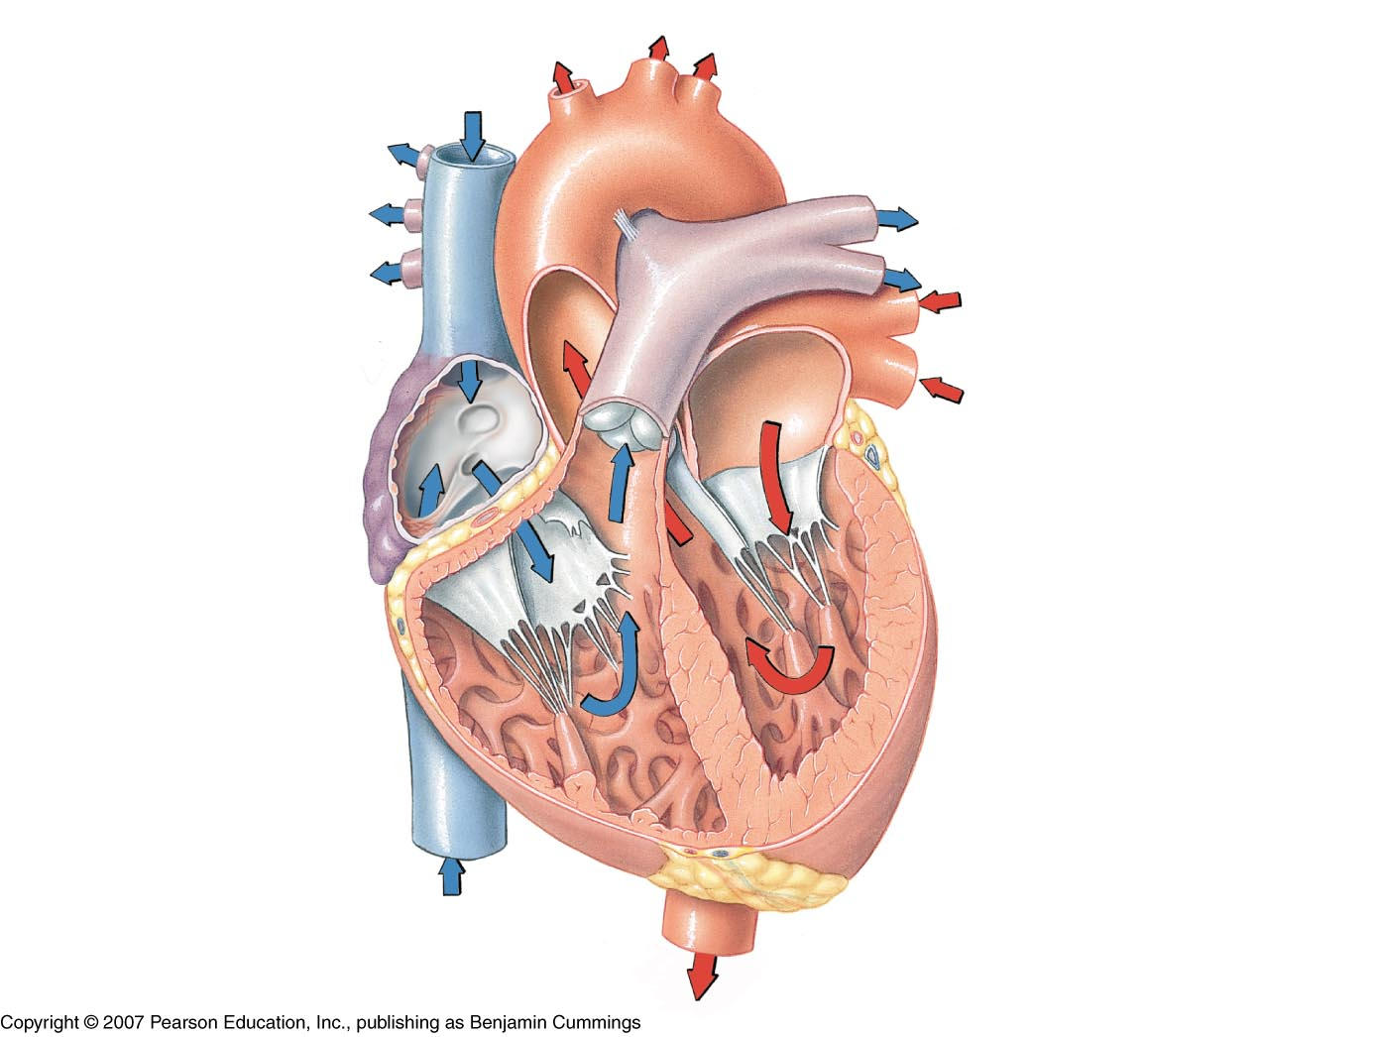
SVC
Interatrial septum
Pulmonary veins
Lt Atrium
Rt Atrium
Pectinate muscles
Bicuspid (mitral) valve
Coronary sinus (opening)
Chordae tendineae
Tricuspid valve
Chordae tendineae
Papillary muscle
Papillary muscle
IVC
Deoxygenated blood
Oxygenated blood

Slide 9
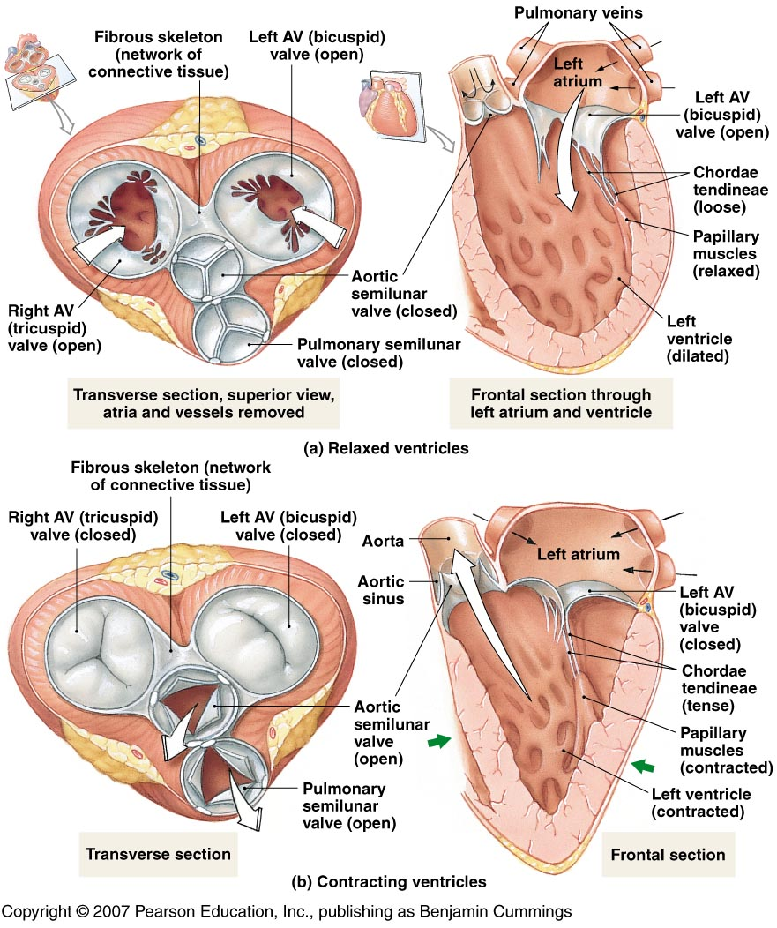
Atrioventricular (AV) valves
Tricuspid
Bicuspid

Slide 10
Lt. common carotid artery artery
Brachiocephalic trunk
Lt. subclavian artery
Aorta
Ligamentum arteriosum
Pulmonary arteries
Pulmonary trunk
Pulmonary semilunar valve
Aortic semilunar valve
Trabeculae carneae
Lt ventricle
Rt ventricle
Interventricular septum

Slide 11
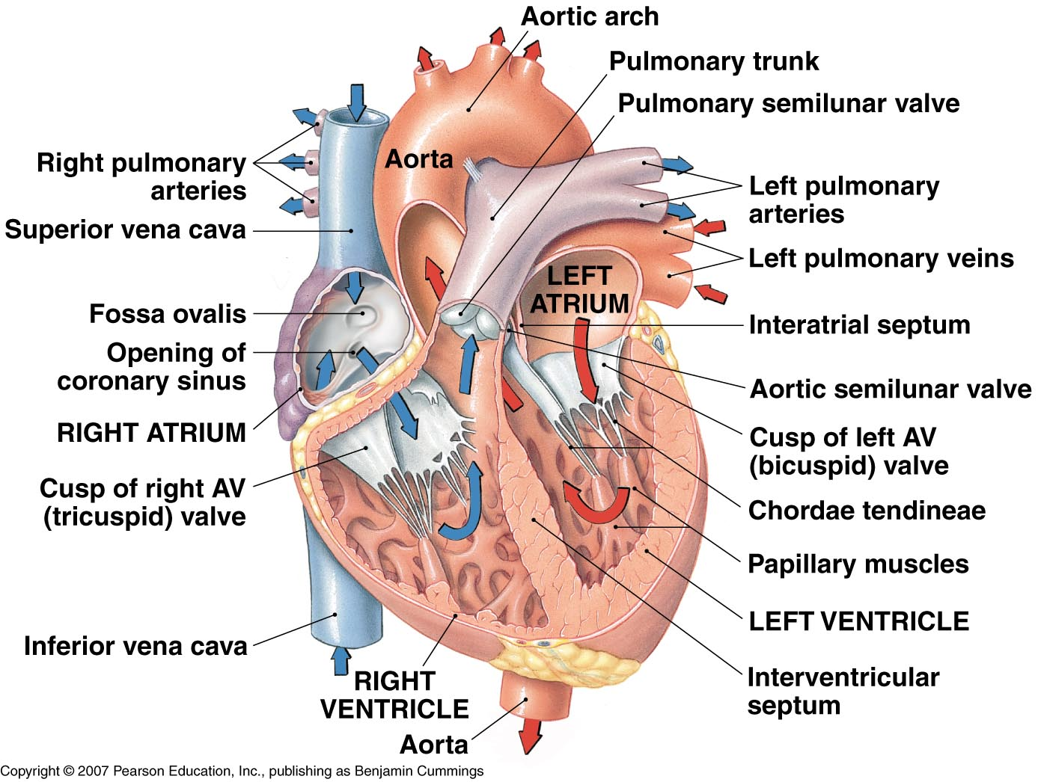
Anatomy

Slide 12
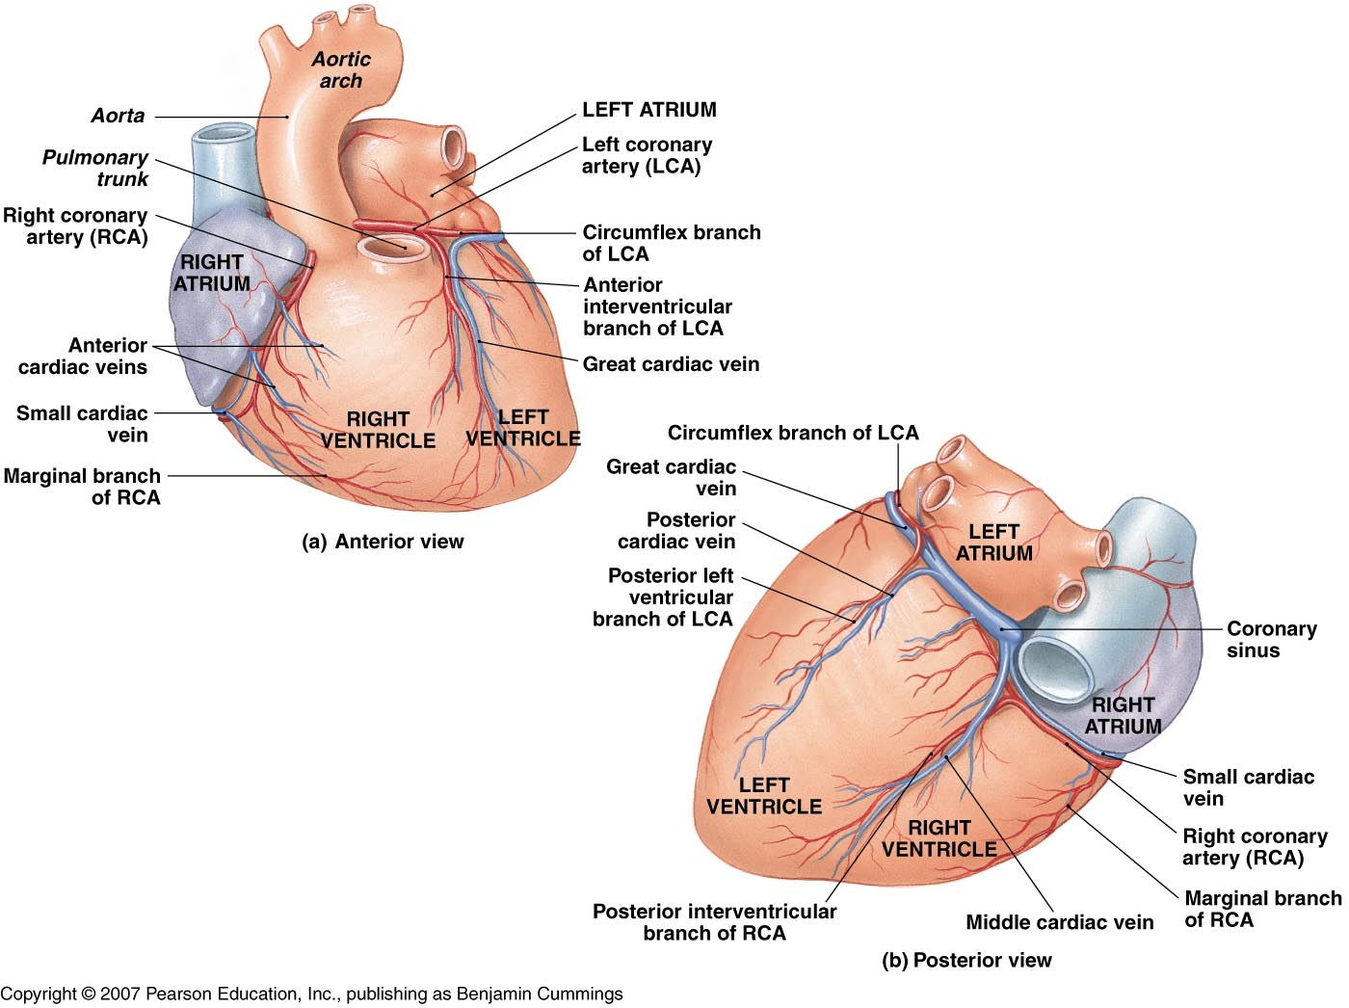
Coronary Circulation
Myocardium receives oxygenated blood from the left & right Coronary arteries – branches off the ascending aorta
Deoxygenated blood is drained through Cardiac veins, which all eventually merge into the coronary sinus
Fig. 12.7

