Slide 1
Introduction to Anatomy & Physiology
Chapter 1

Slide 2
Anatomy
Study of:
- Internal and external structure
- Physical relationships among body parts
Gross anatomy
Microscopic anatomy

Slide 3
Physiology
Study of:
- human body function
Most physiological processes occur to maintain “Homeostasis”

Slide 4
Homeostasis
“Steady State”
Maintain stable internal conditions regardless of external environment
Temperature
Blood pressure
Ionic concentrations
Blood sugar levels, etc.
Homeostasis
But there is a challenge…

Slide 5
STRESS
= anything that disrupts homeostasis
To deal with stress we use Feedback Mechanisms:
Stress
(stimulus)
Control system
Response (effect)
Variation outside normal limits sensed by receptors, info transmitted to control system (nervous &/or endocrine), triggers automatic corrective response via some effector

Slide 6
Homeostatic Regulation
Negative Feedback mechanism:
Response opposes stimulus (& therefore negates effect)

Slide 7
Feedback Mechanisms
Negative Feedback:
Stress
Results in loss of homeostasis
Homeostasis
Negative feedback response
Results in return to homeostasis

Slide 8
Homeostatic Regulation
Positive Feedback mechanism:
Response reinforces the stimulus (& therefore exaggerates the effects)
Occurs only in a few specific circumstances (e.g. childbirth)

Slide 9
Feedback Mechanisms
Positive Feedback:
Results in loss of homeostasis
Positive feedback response
Further loss of homeo-stasis
Stress
Homeostasis

Slide 10
Levels of Organization
Life is built on successive levels of increasing complexity:
Chemical (or Molecular)
Cellular
Tissue
Organ
Organ System
Organism

Slide 11
Chemical
Atoms in
combination
Chemical or
Molecular Level
(Chapter 2)
Complex protein
molecule
Figure 1-1 2 of 7
Copyright © 2007 Pearson Education, Inc., publishing as Benjamin Cummings

Slide 12
Cellular
Atoms in
combination
Chemical or
Molecular Level
(Chapter 2)
Complex protein
molecule
Heart
muscle
cell
Protein filaments
Cellular Level
(Chapter 3)
Figure 1-1 3 of 7
Copyright © 2007 Pearson Education, Inc., publishing as Benjamin Cummings

Slide 13
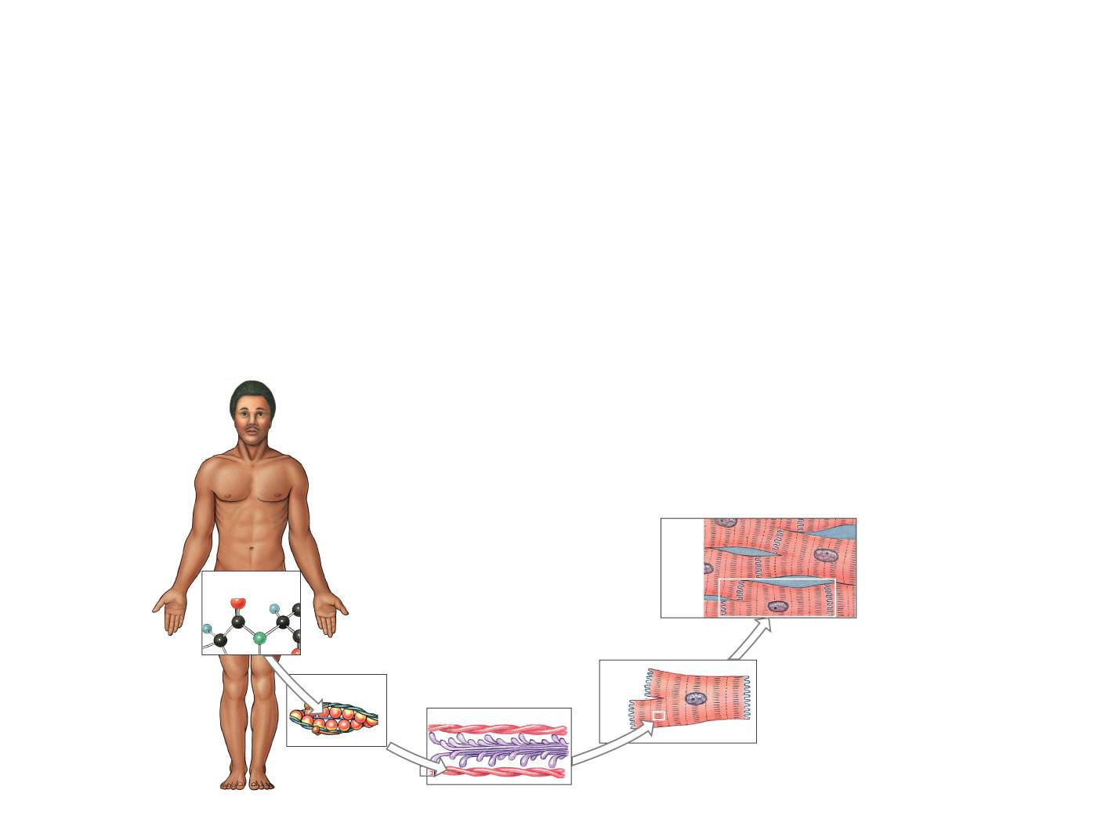
Tissue
Epithelial tissues
Connective tissues
Muscle tissues
Neural (nervous) tissue
Cardiac
muscle
tissue
Atoms in
combination
Tissue Level
(Chapter 4)
Chemical or
Molecular Level
(Chapter 2)
Complex protein
molecule
Heart
muscle
cell
Protein filaments
Cellular Level
(Chapter 3)
Figure 1-1 4 of 7
Copyright © 2007 Pearson Education, Inc., publishing as Benjamin Cummings

Slide 14
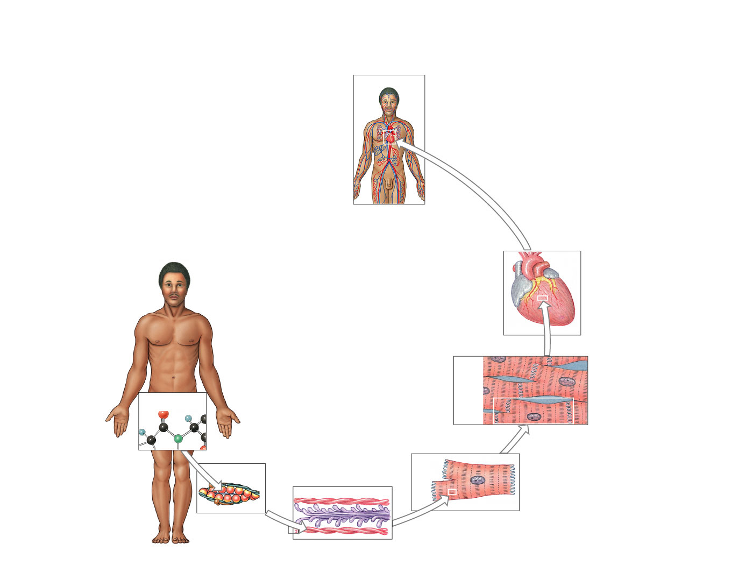
Organ
Cardiovascular
Organ
Level
The
heart
Cardiac
muscle
tissue
Atoms in
combination
Tissue Level
(Chapter 4)
Chemical or
Molecular Level
(Chapter 2)
Complex protein
molecule
Heart
muscle
cell
Protein filaments
Cellular Level
(Chapter 3)
Figure 1-1 5 of 7
Copyright © 2007 Pearson Education, Inc., publishing as Benjamin Cummings

Slide 15
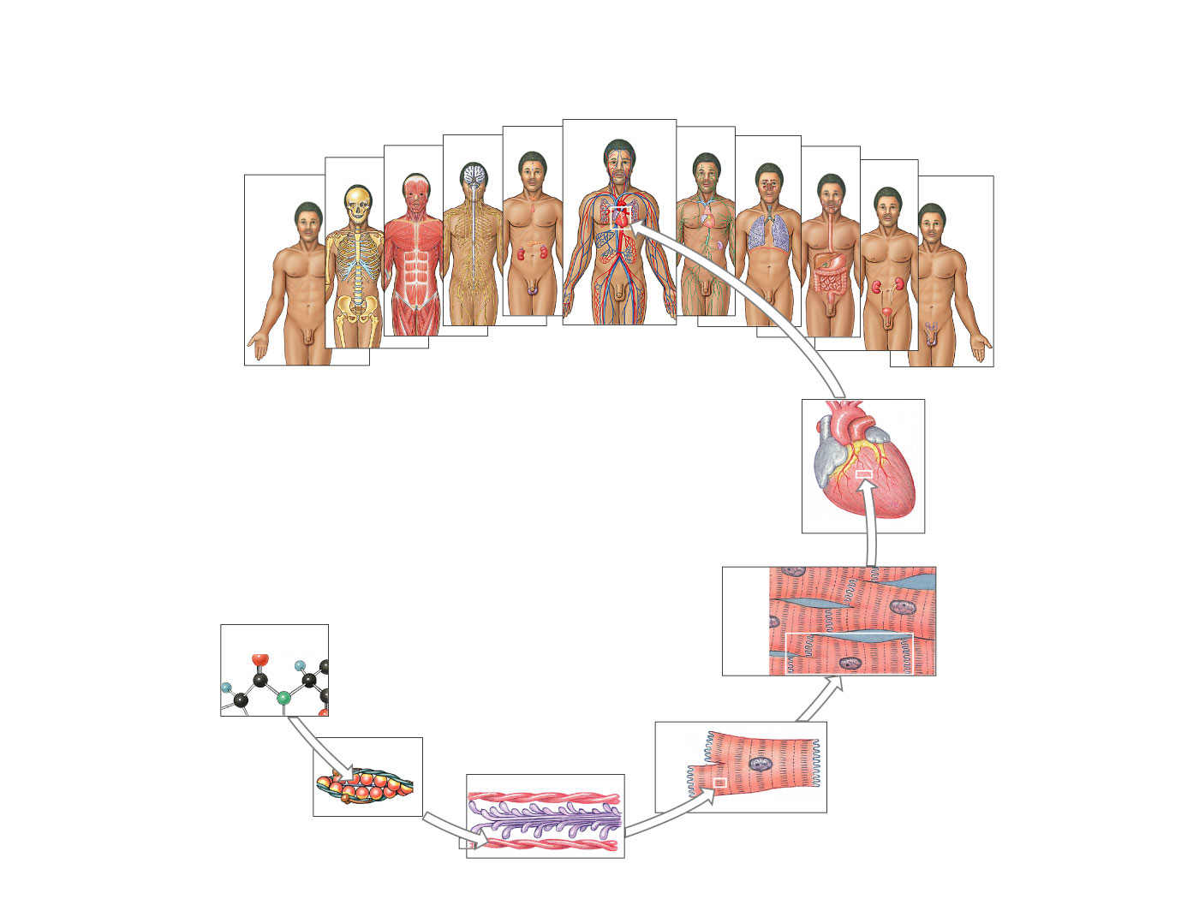
Organ System
Organ
System Level
(Chapters 5–20)
Nervous
Endocrine
Cardiovascular
Lymphatic
Respiratory
Skeletal
Muscular
Digestive
Urinary
Integumentary
Reproductive
Organ
Level
The
heart
Cardiac
muscle
tissue
Atoms in
combination
Tissue Level
(Chapter 4)
Complex protein
molecule
Heart
muscle
cell
Protein filaments
Chemical or
Molecular Level
(Chapter 2)
Cellular Level
(Chapter 3)
Figure 1-1 6 of 7
Copyright © 2007 Pearson Education, Inc., publishing as Benjamin Cummings

Slide 16
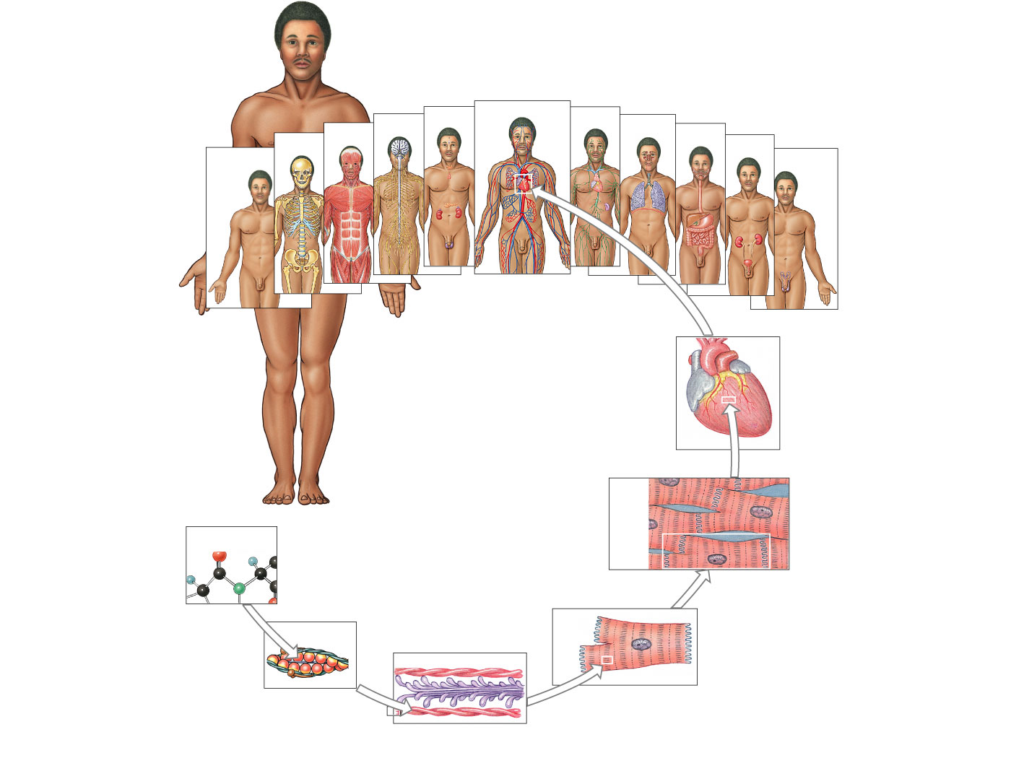
Organism
Organism
Level
Organ
System Level
(Chapters 5–20)
Nervous
Endocrine
Cardiovascular
Lymphatic
Respiratory
Skeletal
Muscular
Digestive
Urinary
Integumentary
Reproductive
Organ
Level
The
heart
Cardiac
muscle
tissue
Atoms in
combination
Tissue Level
(Chapter 4)
Complex protein
molecule
Heart
muscle
cell
Protein filaments
Chemical or
Molecular Level
(Chapter 2)
Cellular Level
(Chapter 3)
Figure 1-1 7 of 7
Copyright © 2007 Pearson Education, Inc., publishing as Benjamin Cummings

Slide 17
Study guide homework
Define: Anatomy
gross anatomy
microscopic anatomy
Define: Physiology
What is homeostasis? Why is it important?
Define: Feedback mechanisms
Explain: negative feedback and give examples
positive feedback and give examples
Apply the concepts of homeostasis and feedback mechanism to situations that occur in the body
Explain the levels of organization of the body
Name the 11 organ systems of the body

Slide 18
The Language of Anatomy
Standardized terminology
Based on Latin & Greek word parts
Utilizes root words, modified with prefixes &/or suffixes

Slide 19
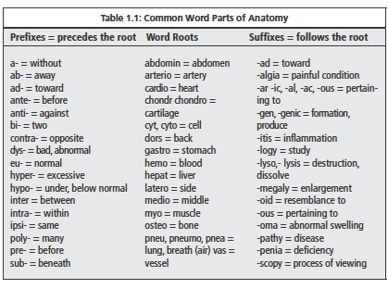

Slide 20
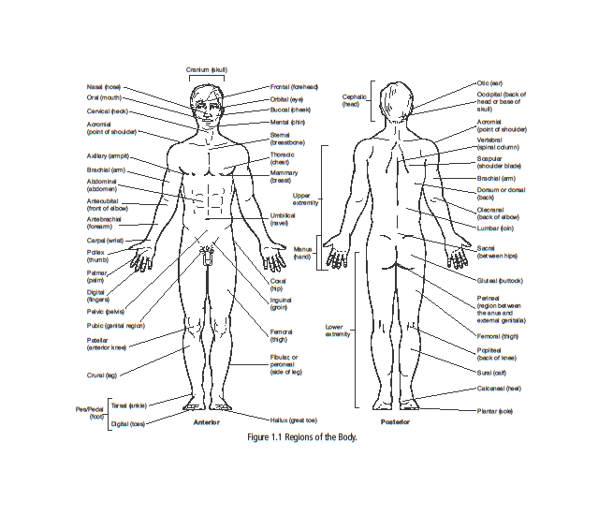

Slide 21
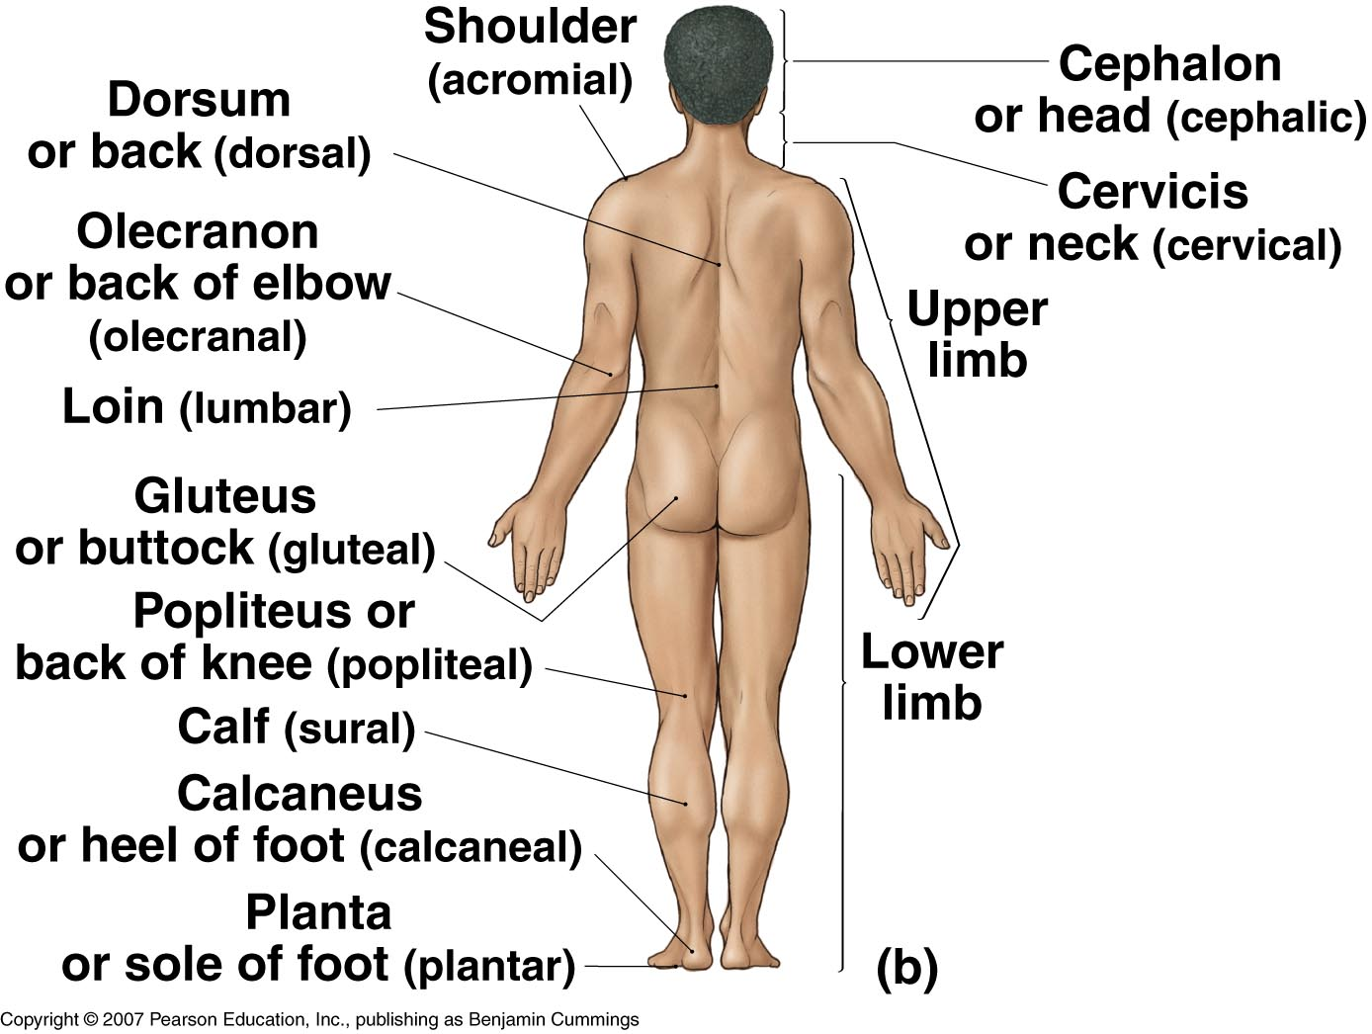
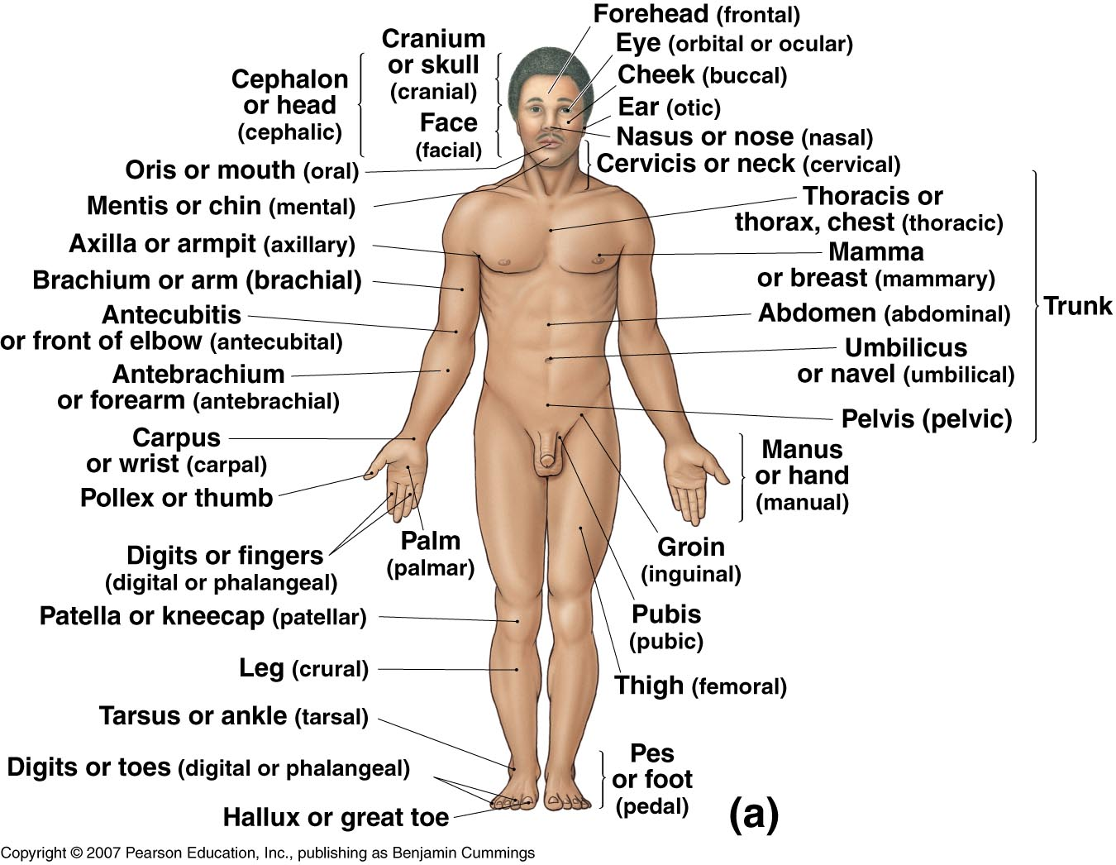
Anatomical Landmarks & Body Regions
Figure 1-6(a)

Slide 22
Anatomical Position
Standard reference position
Hands at side
Palms forward
Feet together
Copyright © 2007 Pearson Education, Inc., publishing as Benjamin Cummings

Slide 23
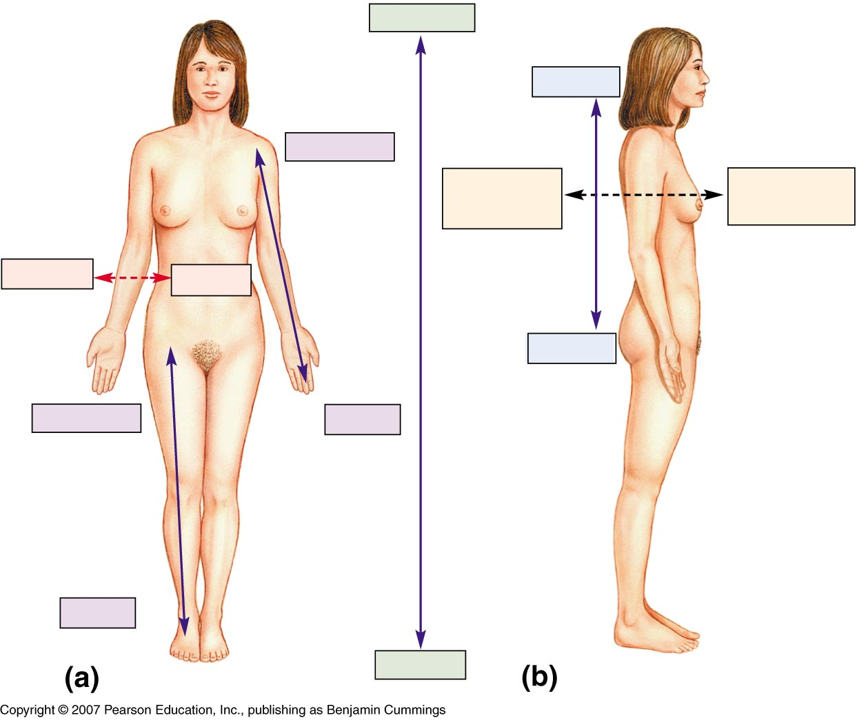
Directional Terms
Superior
Inferior
Inferior

Slide 24
Directional Terms
Superior
Cephalic Cranial
Posterior or dorsal
Anterior or ventral
Lateral
Medial
Caudal
Inferior
Inferior

Slide 25
Directional Terms
Superior
Cephalic Cranial
Proximal
Posterior or dorsal
Anterior or ventral
Lateral
Medial
Caudal
Inferior
Proximal
Distal
Distal
Inferior

Slide 26
Directional Terms
Superficial
Deep
Prone
Supine

Slide 27
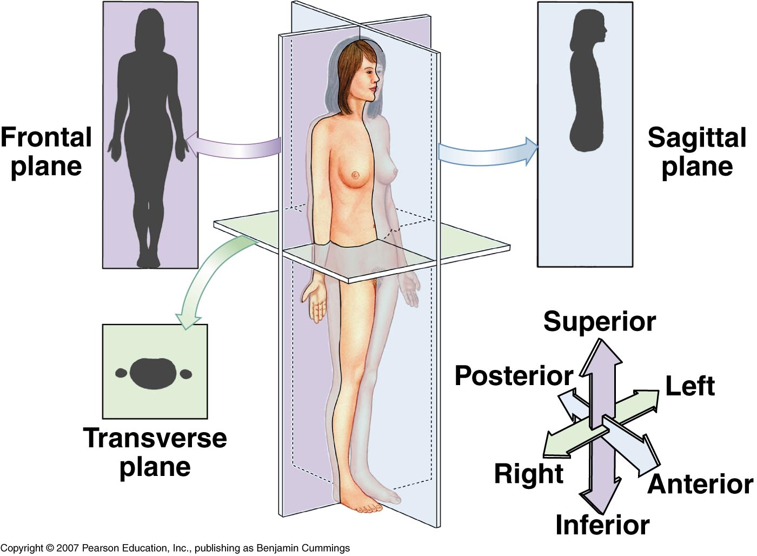
Body Planes & Sections
Longitudinal planes/sections
Sagittal
midsagittal
parasagittal
Coronal/Frontal
Transverse Plane
Cross-section

Slide 28
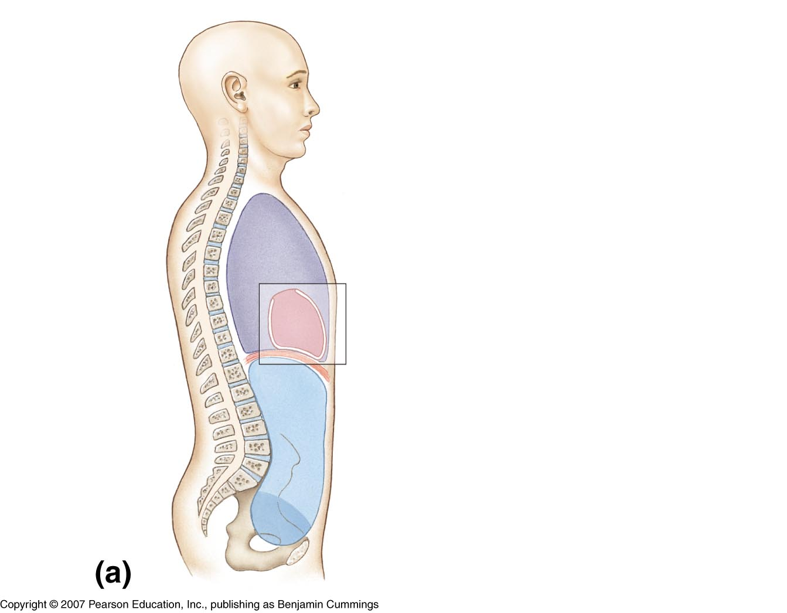
Body Cavities
Cranial cavity
Spinal cavity
Ventral body cavity

Slide 29
Body Cavities
Diaphragm subdivides ventral body cavity into:
Thoracic cavity
Abdominopelvic cavity

Slide 30
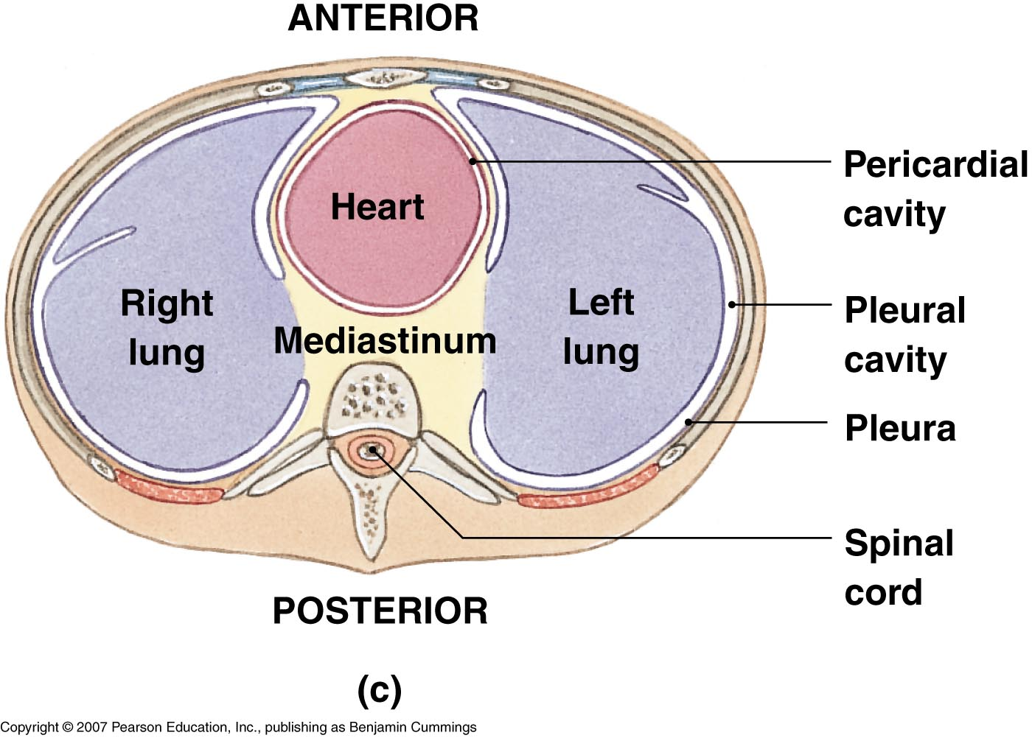
Ventral Body Cavity
Thoracic cavity
Pleural cavities (R and L)
Mediastinum
Pericardial cavity

Slide 31
Ventral Body Cavity
Abdominopelvic cavity:
Abdominal cavity
Pelvic cavity

Slide 32
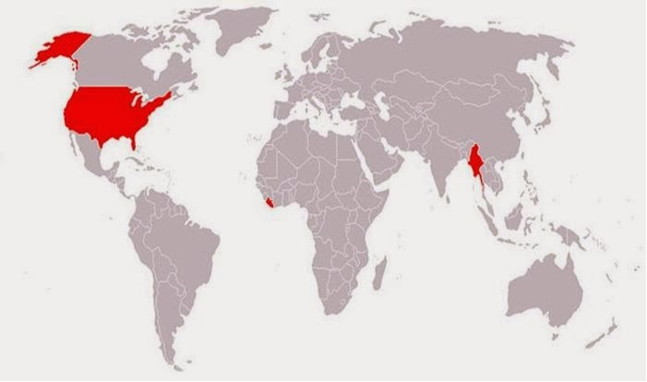
The Metric System
Standard system of measurement used in science & around the world
This map shows (in red) the countries that don't use the metric system.

Slide 33
The Metric System
Standard system of measurement
Based on units of 10
Utilizes a standard metric unit depending upon whether you are measuring
length – meter (m)
volume – liter (L)
mass – gram (g)

Slide 34
The Metric System
The standard units of measurement (m, L, g) can be modified by the addition of a prefix, which will change the value of the measurement
The most commonly used prefixes include:
mega (M) = 1,000,000
kilo (k) – 1000
centi (c) – 1/100
milli (m) – 1/1000
micro (u) – 1/1,000,000
nano (n) – 1/1,000,000,000

Slide 35
The Metric System
To change from smaller units --> larger units, you must DIVIDE by the appropriate factor of 10 (because there or less larger units that fit into the number).
ie: 1 millimeter (1mm) = 1/1000 meters = 0.001 m
5 millimeters (5mm) = 5/10 centimeters (cm) = 0.5 cm
Note: dividing a number by a factor of 10 is the same thing as moving the decimal point to the LEFT.

Slide 36
The Metric System
To change from larger units --> smaller units, you must MULTIPLY by the appropriate factor of 10 (because there are more smaller units that go into the number).
ie: 5 km = 5,000 m
3 kg (kilograms) = 3,000,000 mg (milligrams)
= 3x 10⁶ mg
Note: multiplying a number by a factor of 10 is the same as moving the decimal to the RIGHT.

Slide 37
The Metric System
Multiply------>---->---->
l__l__ l__l___l____l_____l_____l___l__ _l_ _l_ _l__l__ l __l__l
M k h da "unit“ d c m u n
(m/l/g)
<------<------<-------Divide
Mega
kilo
hecto
deca
deci
centi
milli
micro
nano
meter/liter/gram
(1,000,000)
(1000)
(10)
(1)
(1/10)
(1/1,000,000,000)
(100)
(1/100)
(1/1000)
(1/1,000,000)

Slide 38
Study guide homework
Understand the definition of specific anatomical terminology based upon analysis of the root term, prefix and suffix associated with the word
Use the following anatomical Landmarks (noun) & regions (adjective) of the body appropriately and in place of the common body terms:
Cephalon (cephalic)
Cranium (cranial) Gluteus (gluteal)
Oris (oral) Inguen (inguinal)
Cervicis (cervical) Pubis (pubic)
Thoracis/thorax (thoracic) (note: also relates to vertebrae)
Abdomen (abdominal) Femur (femoral)**
Umbilicus (umbilical) Patella (patellar)**
Lumbus/Loin (lumbar) Popliteus (popliteal)**
Pelvis (pelvic) Crus (crural)**
Acromion (acromial)* Sura (sural )**
Axilla (axillary)* Tarsus (tarsal)**
Brachium (brachial)* Calcaneus (calcaneal)**
Antecubitis (antecubital)* Pes (pedal)**
Olecranon (olecranal)* Planta (plantar)**
Antebrachium (antebrachial)* Digits/Phalanges (digital/phalangeal)**
Carpus (carpal)* Hallux**
Manus* (** indicates parts of lower extremity)
Palm (palmar /volar)*
Digits/Phalanges (digital/phalangeal)*
Pollex*
(* indicates parts of upper extremity)

Slide 39
Describe the human anatomical position and its importance in clinical settings
Define and use the following appropriate directional terms:
superior (cephalic/cranial)
inferior (caudal)
anterior
ventral
posterior
dorsal
proximal
distal
lateral
medial
superficial
deep
ipsilateral
contralateral
prone
supine
Identify the common body planes & sections
Longitudinal
Sagittal
Midsagittal
Coronal/Frontal
Transverse (Cross section)

Slide 40
Describe the location of the main body cavities and know the major organs which lie within them:
Cranial cavity
Spinal cavity
Ventral body cavity
Thoracic
Pleural
Mediastinum
Pericardial
Abdominopelvic
Abdominal
Pelvic
Name the specific serous membranes found in the ventral body cavity and be able to describe the difference between the parietal and visceral layers of these membranes.
Understand and utilize the metric system of measurement, including the appropriate standard units and values of common metric prefixes
Convert numerical values within the metric system (e.g. 50mm = _____ cm)

