Slide 1
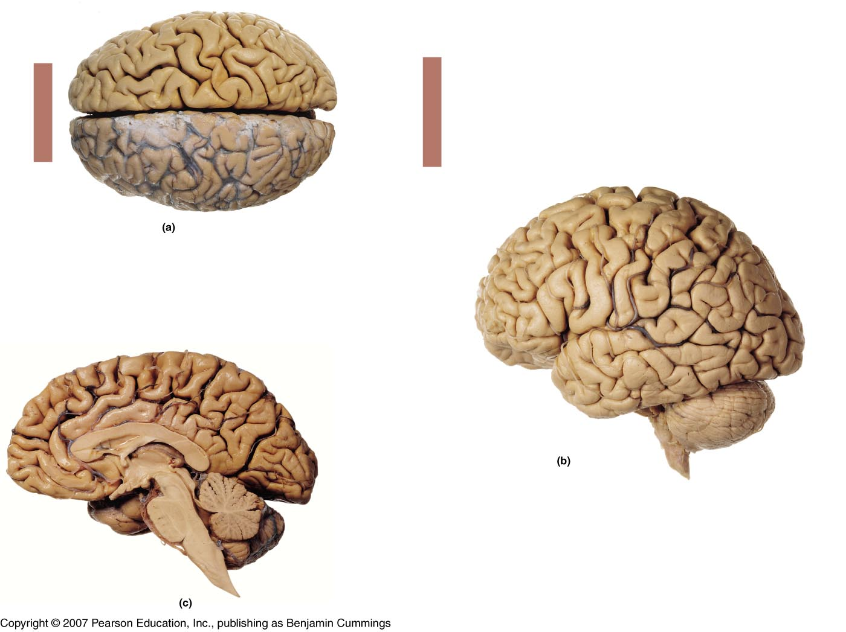
The Nervous System Chapter 8 – The Central & Peripheral Nervous System

Slide 2
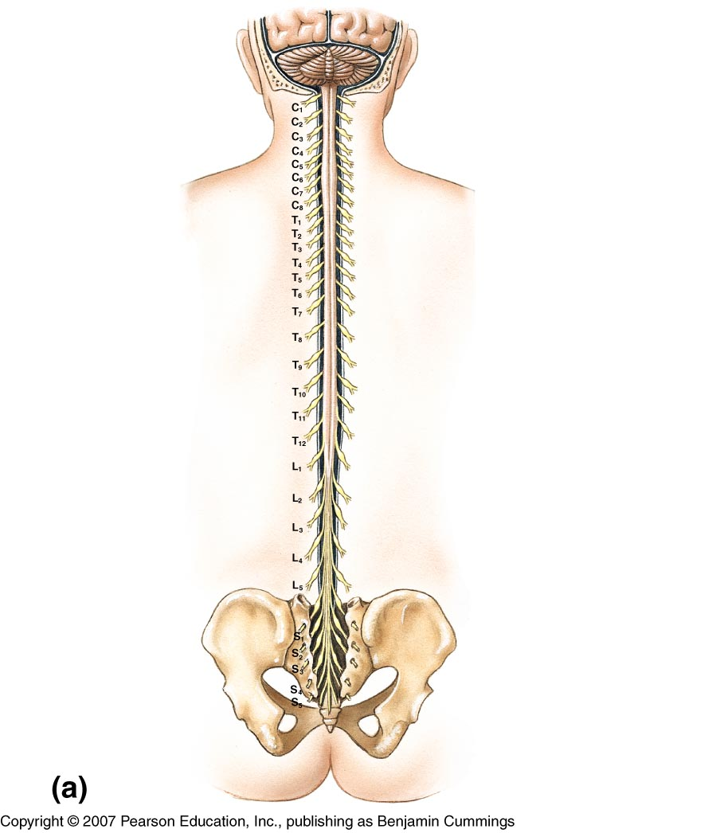
Central Nervous System (CNS)
Brain enclosed within cranium -Comprised of four major regions: Cerebrum, Cerebellum, Diencephalon, Brainstem
Spinal Cord begins at foramen magnum, runs through vertebral foramen (spinal canal), and ends at L2 vertebral level by forming conus medularis
CNS is well protected by bones, CT meninges, and fluid (cerebrospinal fluid (CSF))

Slide 3
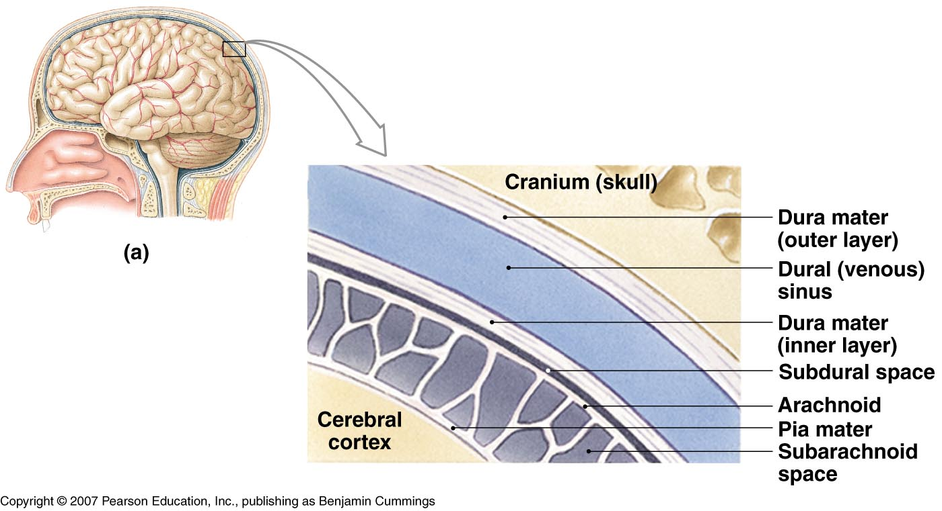
Meninges
Membranes that surround and protect the CNS
Three layers:
Dura mater
Arachnoid mater
Pia mater

Slide 4
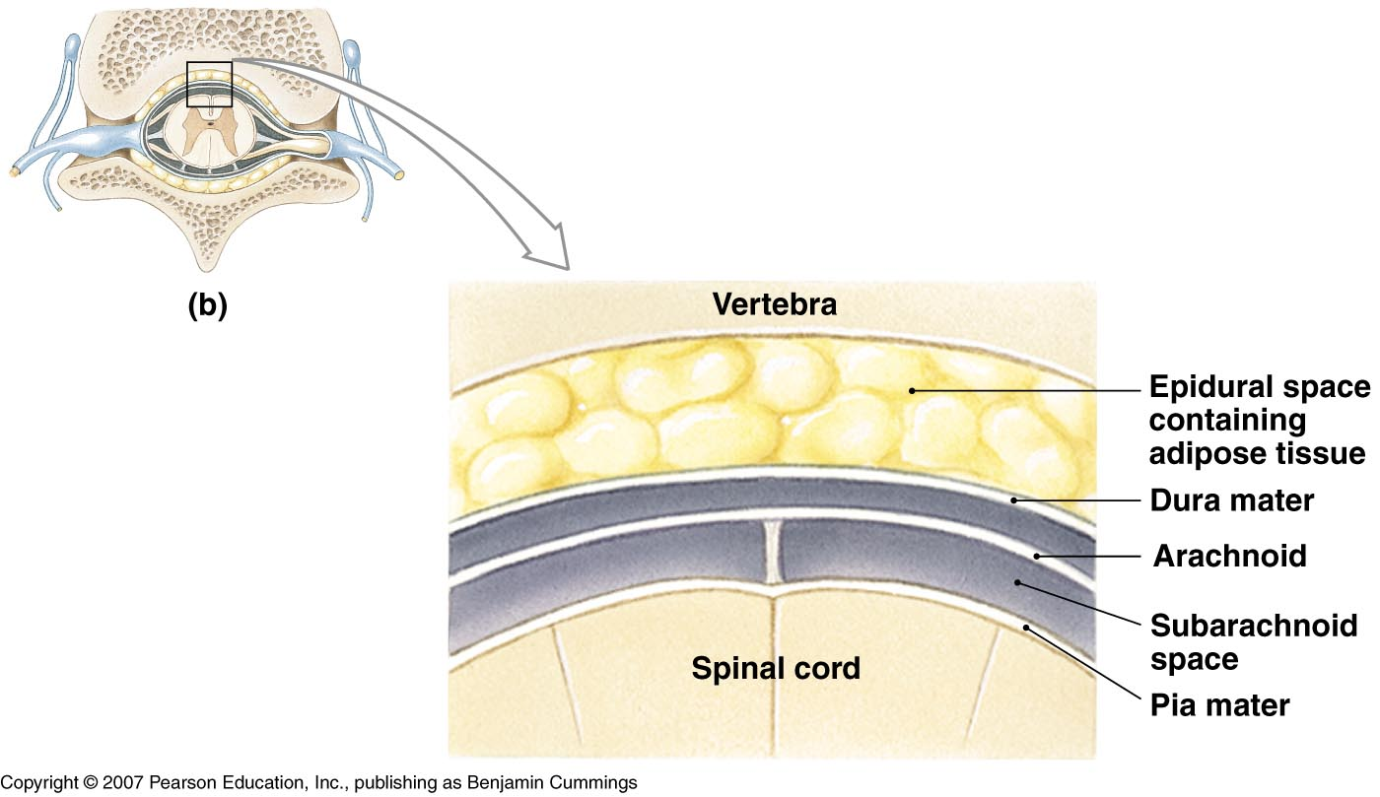
Dura Mater – tough, fibrous outer layer;
2 layers thick around brain with creation of dural sinuses between layers;
1 layer around spinal cord with epidural space external

Slide 5
Arachnoid – “spidery” web-like middle layer
Pia Mater – delicate, thin inner layer; extension of pia mater (“filum terminale”) extends from tip of cord to coccyx to anchor cord in place
Subarachnoid space – between arachnoid & pia mater; contains cerebral spinal fluid (CSF)
sample of CSF can be taken at subarachnoid space inferior to the conus medularis by “lumbar puncture” (spinal tap)

Slide 6
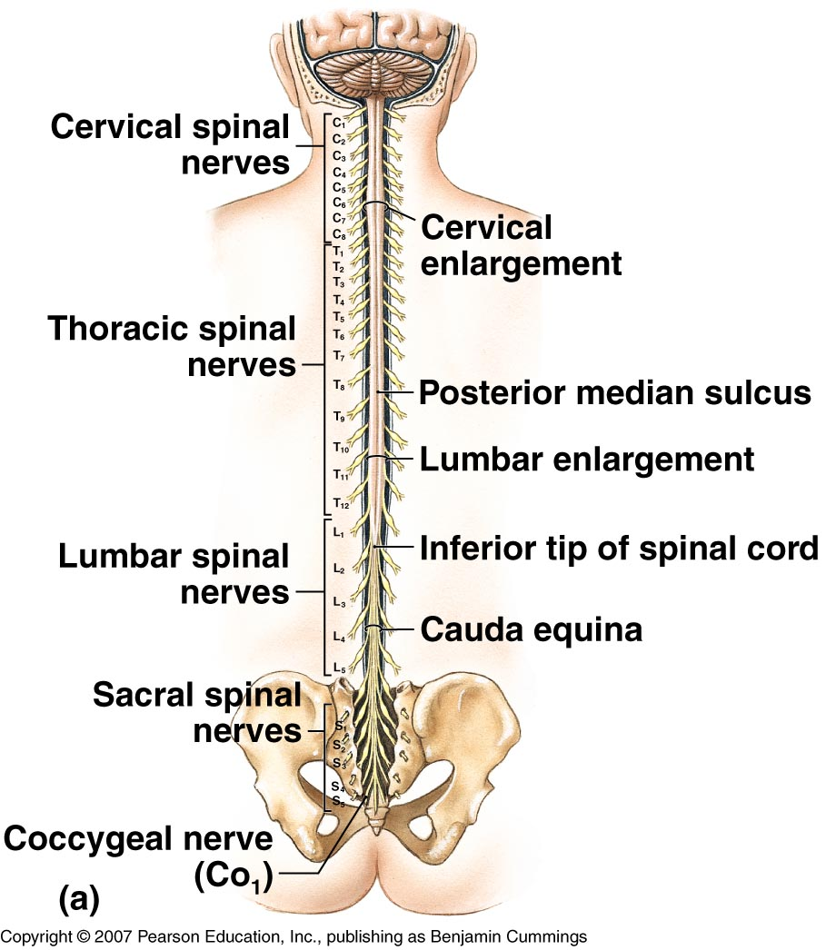
The Spinal Cord
Begins at foramen magnum & ends at L2 vertebral level by forming conus medularis
Has 2 thickened areas
cervical enlargement - supplies nerves to upper extremity
lumbar enlargement - supplies nerves to lower extremity
(conus medularis)
Made up of 31 spinal cord segments

Slide 7
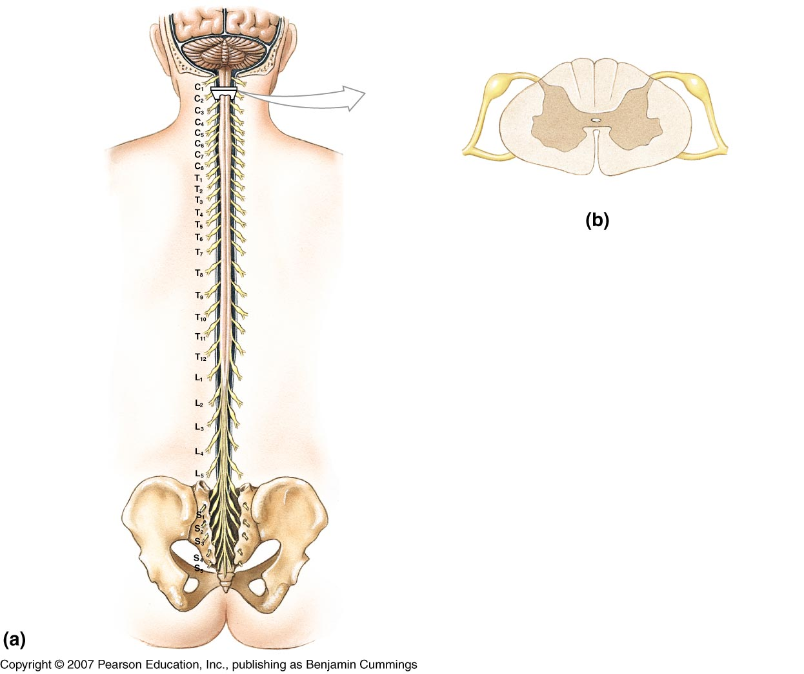
Dorsal root ganglion (DRG)
Dorsal root
Ventral root
Each spinal cord segment has a pair of
dorsal roots with their associated dorsal root ganglia (DRG)
ventral roots

Slide 8
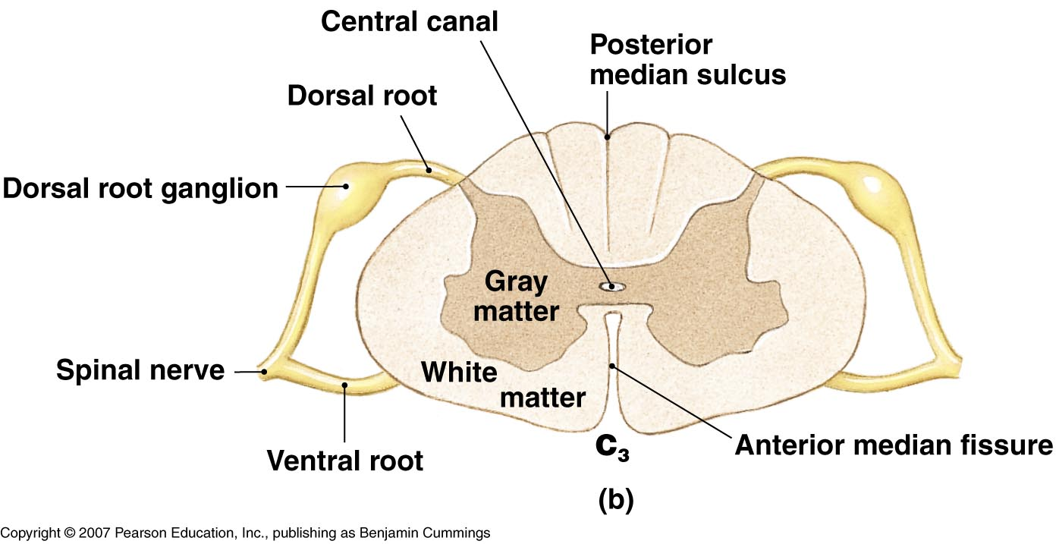
Each dorsal root contains the axons of sensory neurons (unipolar neurons)
Each dorsal root ganglion contains the cell bodies of these sensory neurons
Each ventral root contains the axons of motor neurons (multipolar neurons whose cell bodies are within the cord)

Slide 9
The dorsal & ventral roots of each segment come together at the intervertebral foramen (IVF) to form a mixed spinal nerve

Slide 10
Spinal Nerves
Part of the PNS
Contain both motor & sensory fibers (“mixed nerve”)
31 pair of nerves – each nerve forms from union of dorsal/ventral root of spinal cord segment & exits between vertebra at IVF (intervertebral foramen)
8 pair cervical spinal nerves – 1st cervical nerve exits between occipital bone & C1, 8th cervical nerve exits the IVF between C7-T1
12 pair thoracic spinal nerves
5 pair lumbar nerves
5 pair sacral nerves
1 pair coccygeal nerves

Slide 11
Below the conus medularis, spinal nerves must angle downward (in the subarachnoid space) before exiting their IVF. These spinal nerves make up the cauda equina
Cauda equina

Slide 12
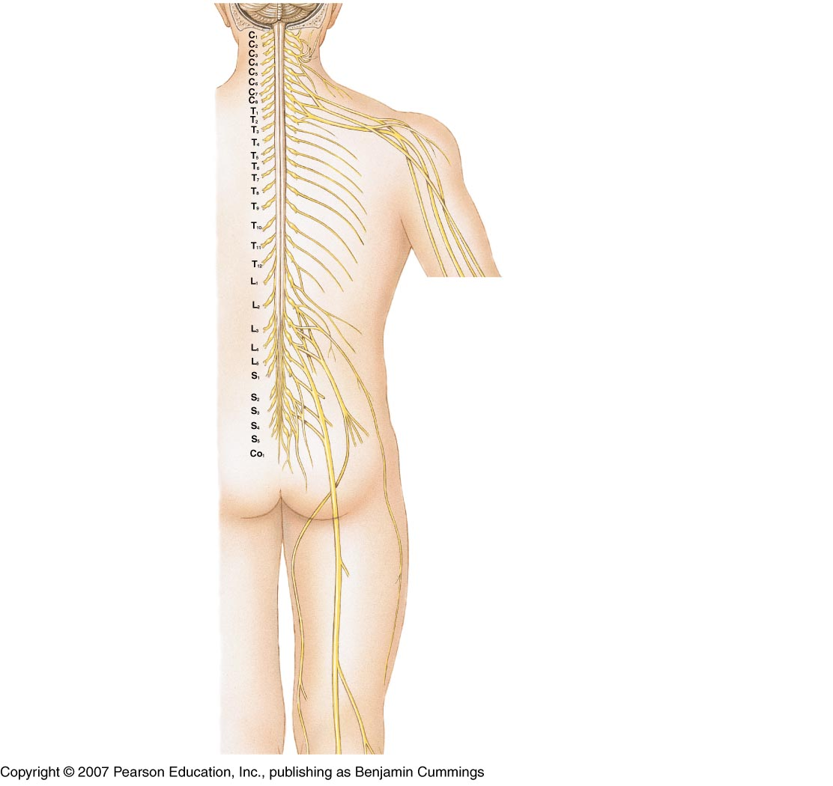
Spinal Nerves
Once formed, spinal nerves will branch
The branches of most spinal nerves (comprised of axons) interweave to form nerve plexuses
peripheral nerves then branch from the plexuses to provide motor & sensory innervation to specific areas of the body

Slide 13
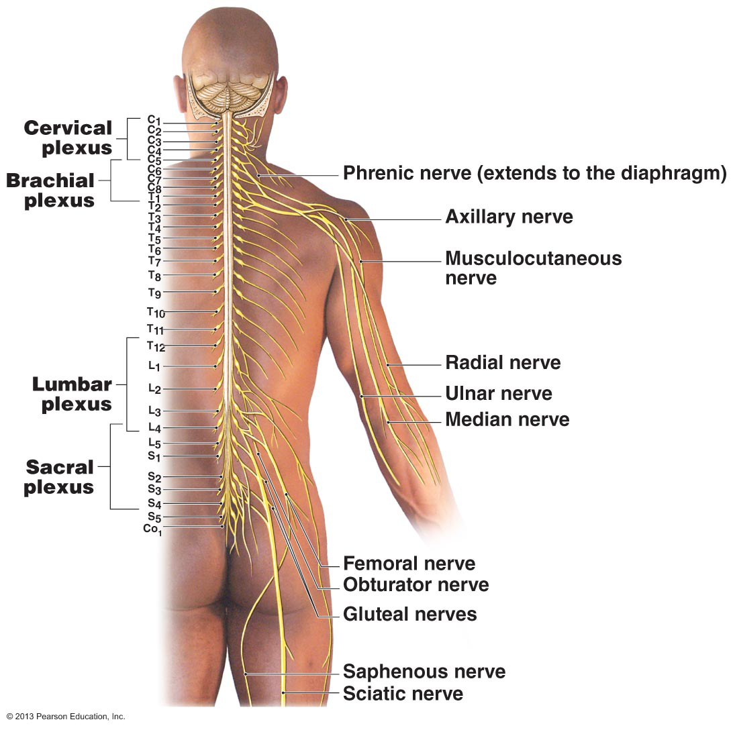
Nerve Plexus
4 major plexuses
cervical
brachial
lumbar
sacral

Slide 14
Spinal Nerve plexuses
Cervical plexus (C1-C5)
gives off phrenic nerve
Brachial plexus (C5-T1)
gives off median, ulnar
& radial nerve
Lumbar plexus (T12-L4)
gives off femoral nerve
Sacral plexus (L4-S4)
gives off sciatic nerve
No plexus forms between T2-T11 – intercostal nerves

Slide 15
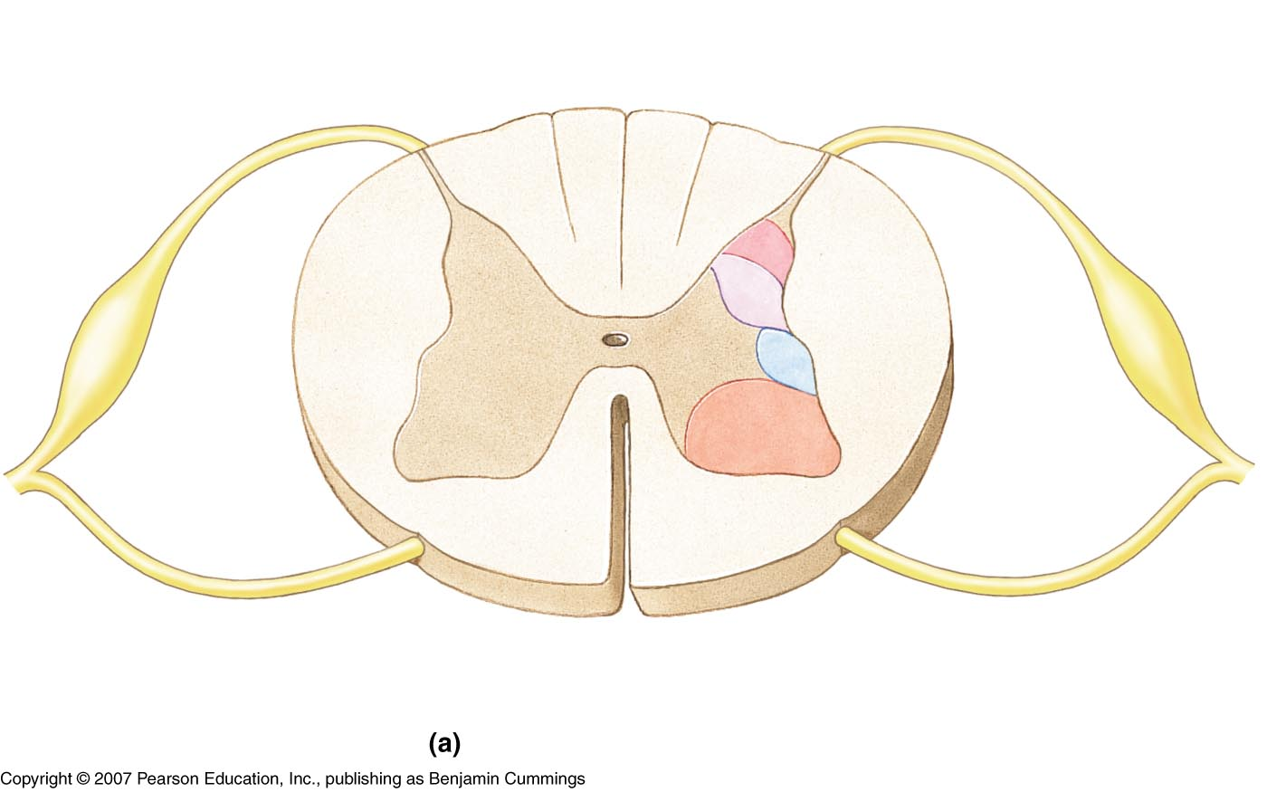
Sectional Anatomy of the Spinal cord
Posterior median sulcus
Posterior column
Posterior gray horn - sensory
Central canal
Lateral column
Lateral gray horn (T1-L2, S2-S4) - autonomic
Gray commissure
Anterior gray horn - motor
Anterior column
Anterior median fissure

Slide 16
The spinal cord has a narrow central canal surrounded by “horns” of gray matter connected by a commissure. Gray matter horns contain sensory & motor nuclei (groups of cell bodies).
Gray matter is surrounded by white matter “columns” which are made up of groups of myelinated axons creating organized ascending & descending tracts.

Slide 17
Tracts (Sensory & Motor Pathways)
Groups of axons found in the white matter columns of the spinal cord that carry specific information
Ascending tracts - carry sensory information up the spinal cord to areas of the brain
Descending tracts – carry motor information from the brain down to specific levels of the spinal cord
Ascending & descending tracts within the spinal cord are part of the sensory & motor pathways of the nervous system

Slide 19
Ascending Tracts (sensory pathways)
Spinothalamic tracts
carries poorly localized touch, pressure, pain & temperature from cutaneous receptors to the thalamus
from thalamus, some of this sensory info reaches primary sensory cortex of the cerebrum for “interpretation” & conscious awareness

Slide 20
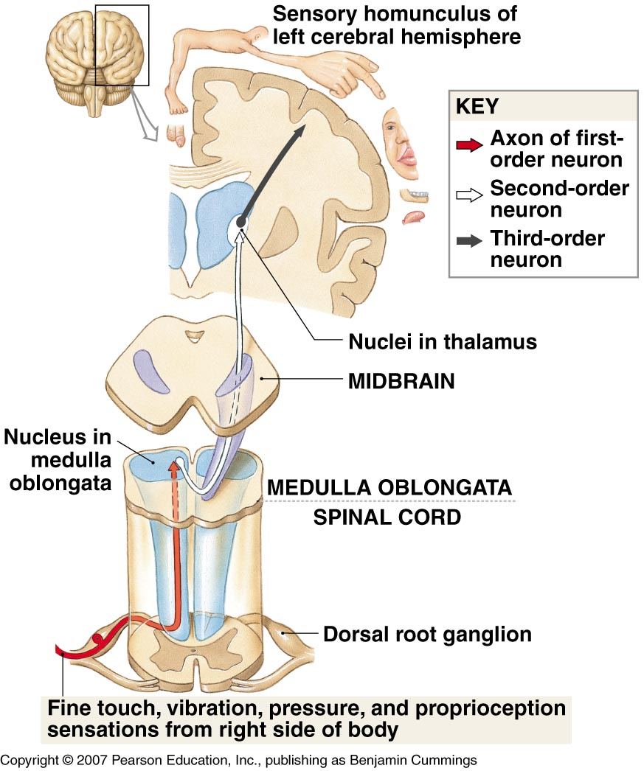
Ascending Tracts (sensory pathways)
Posterior Columns
carries highly localized discriminative (fine) touch, vibration, conscious proprioception (position sense) to nucleus in medulla oblongata (M.O.)
from M.O., info travels along rest of pathway to thalamus & then to primary sensory cortex of cerebrum

Slide 21
Ascending Tracts (sensory pathways)
Spinocerebellar
carries proprioceptive (positional) information to the cerebellum (unconscious awareness)

Slide 22
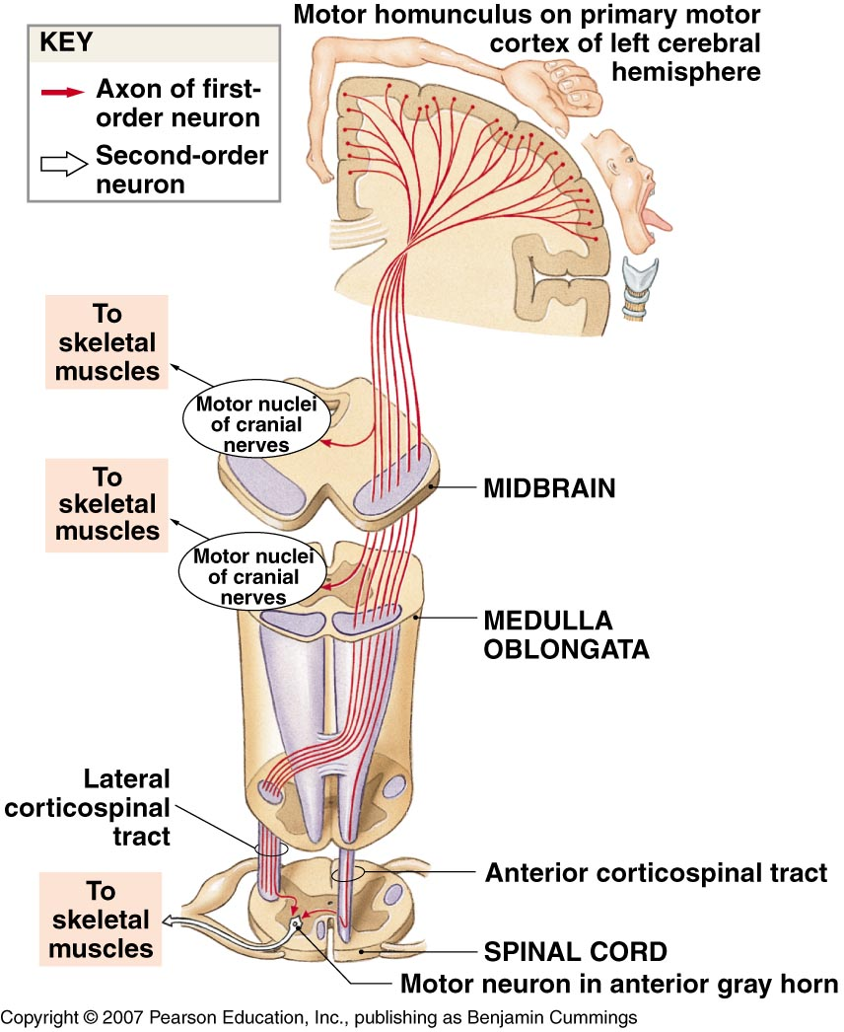
Descending Tracts (motor pathways)
Corticospinal (pyramidal)
carries commands from primary motor cortex of cerebrum for conscious (voluntary) control of skeletal muscles.
most fibers cross in “pyramidal decussation” of medulla oblongata so that left cerebral cortex controls muscles on right side of body, & vice-versa.

Slide 23
Descending Tracts (motor pathways)
Medial & lateral pathways
originate from a variety of brain nuclei & send signals to motor neurons in the spinal cord for (subconscious) coordination of skeletal muscle activity, maintenance of posture & muscle tone.

Slide 24
Ascending & descending tracts are part of larger sensory & motor pathways
These sensory & motor pathways include the afferent & efferent neurons of the PNS
Sensory & motor information gets in/out of spinal cord via spinal nerves

Slide 25
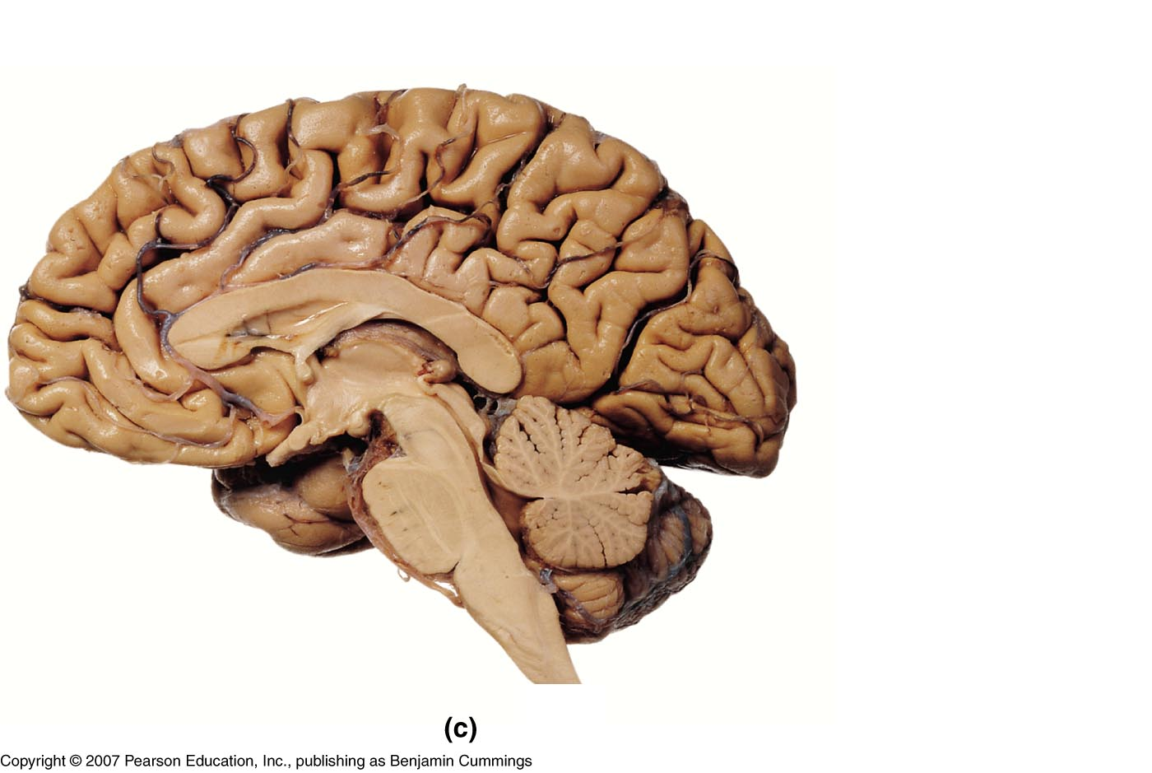
The Brain
Brain stem
medulla oblongata (M.O.)
pons
midbrain
Diencephalon
thalamus
hypothalamus
epithalamus (pineal gland)
mamillary body
Cerebrum
Cerebellum
Cerebrum
T
P
P
H
M
midbrain
Cerebellum
pons
m.o.

Slide 26
Cerebrospinal Fluid (CSF)
clear, colorless fluid formed by filtration of blood plasma by choroid plexuses within ventricles of the brain.
circulates through ventricles, into central canal of spinal cord & around brain & SC in subarachnoid space. Reabsorbed through arachnoid granulations into dural sinuses & then into bloodstream
functions in protection of CNS, support, nutrient supply, waste removal
sample of CSF can be taken at subarachnoid space inferior to the conus medularis by “lumbar puncture” (spinal tap)

Slide 27
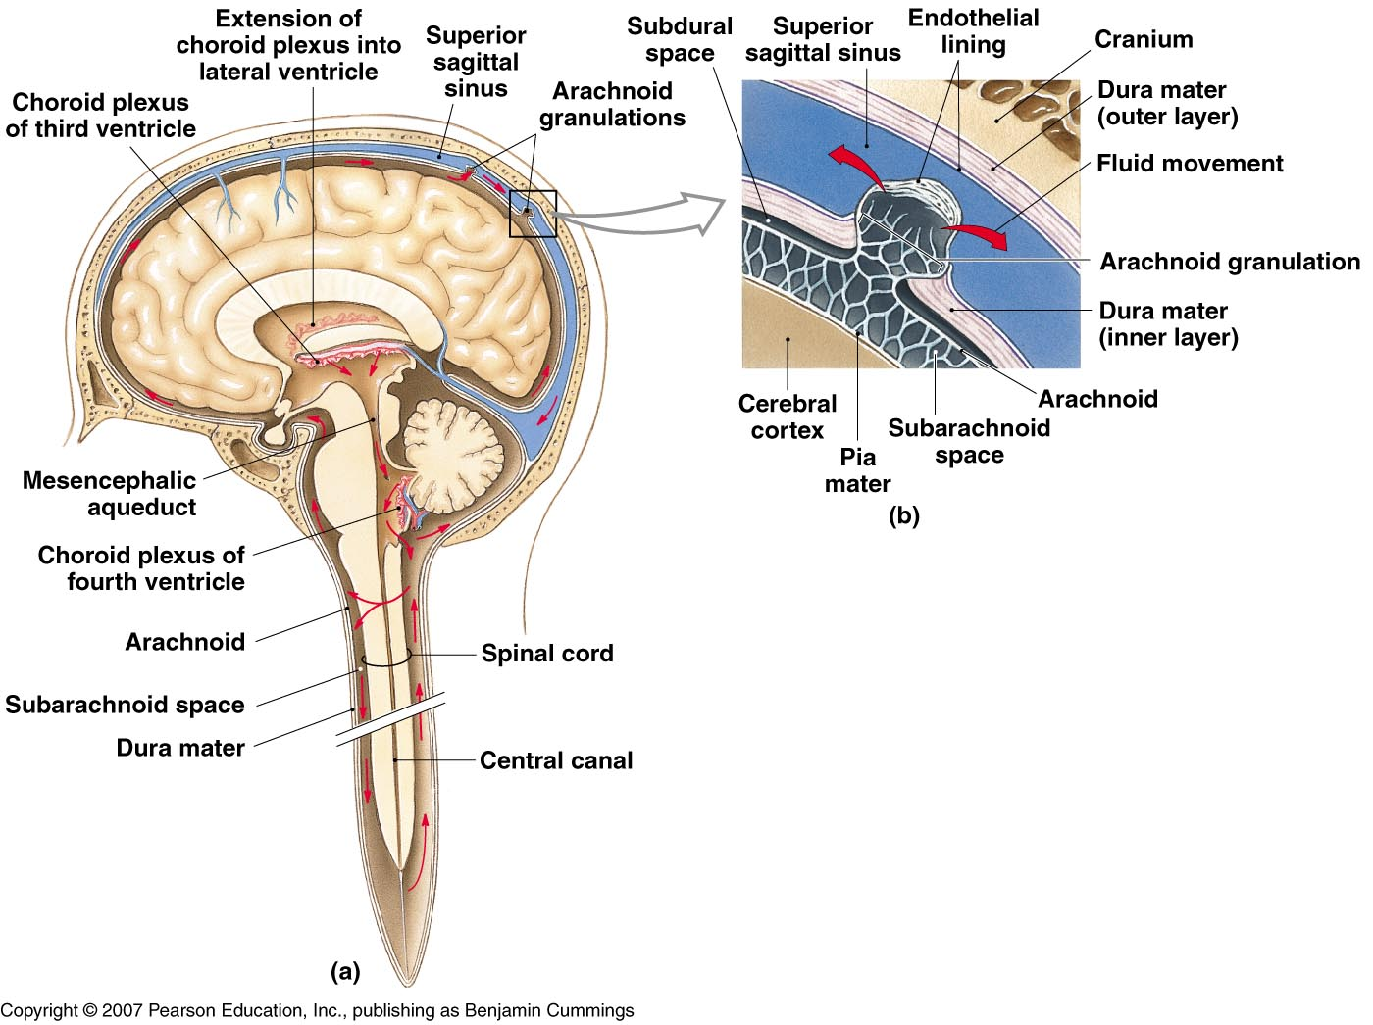
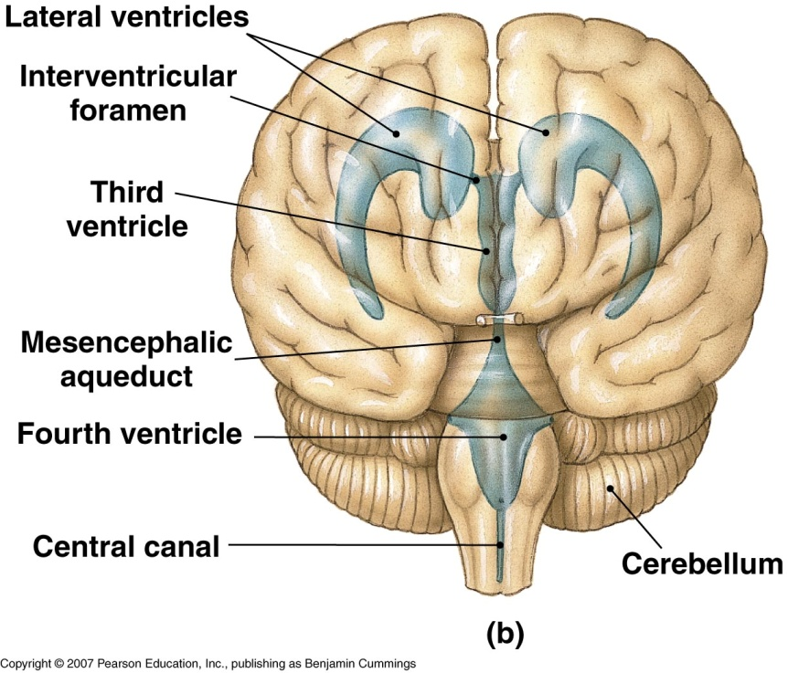
CSF Circulation

Slide 28
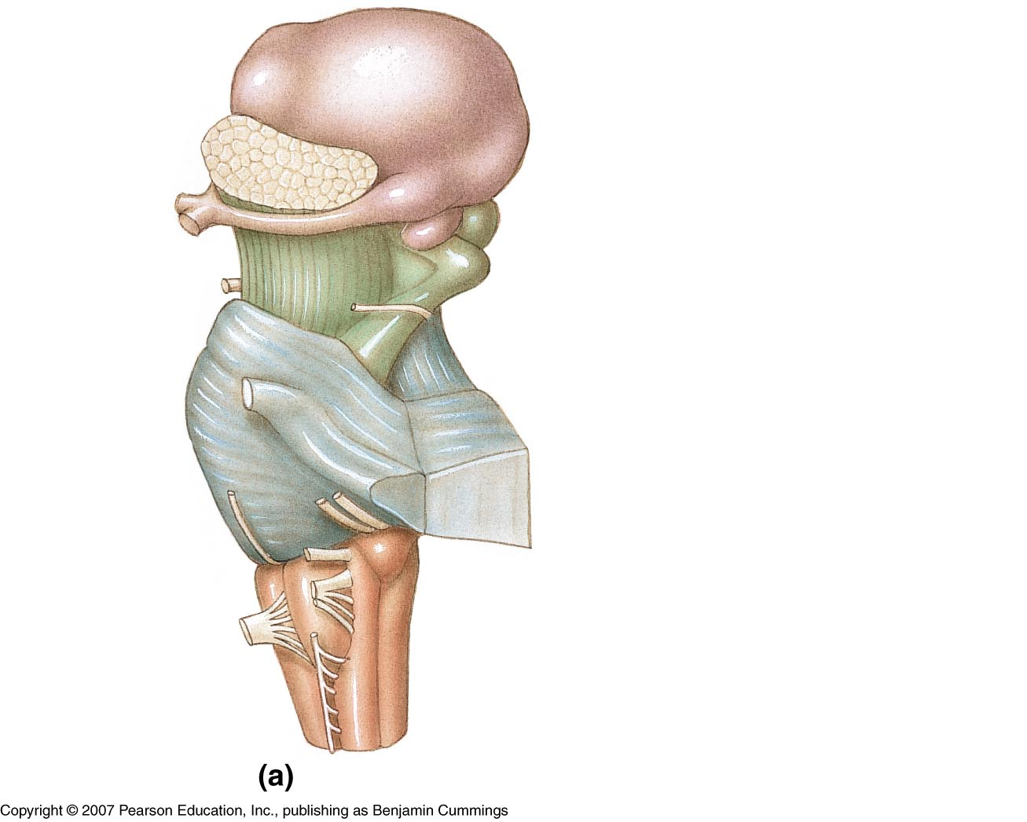
The Brainstem
Medulla oblongata
continuation of the SC above the foramen magnum
contains the pyramidal decussation
cranial nerve nuclei (XII-VIII (cochlear)
cardiac, vasomotor, & respiratory reflex centers
Pons
“bridge” linking cerebellum to SC & other parts of brain
cranial nerve nuclei (VIII (vestibular) – V)
respiratory center

Slide 29
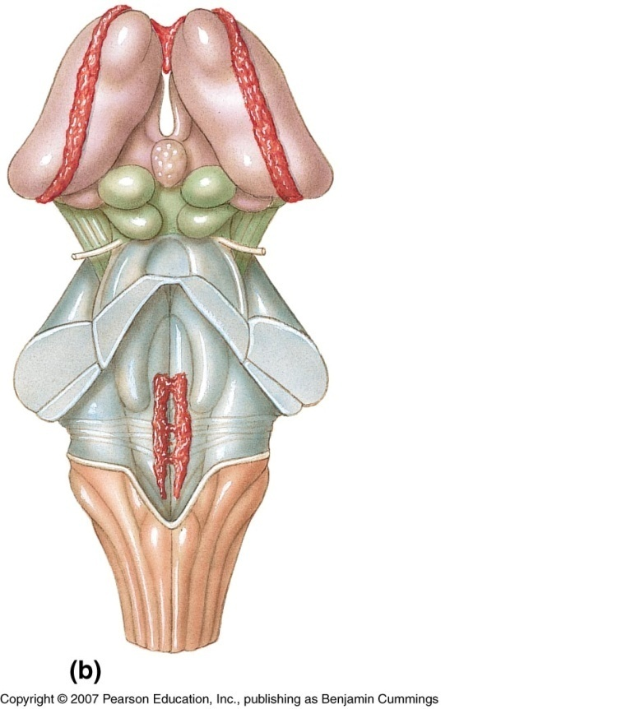
The Brainstem
Midbrain
cerebral peduncles – location of ascending (sensory) & descending (motor) tracts
corpora quadrigemina
superior colliculi – visual reflex centers
inferior colliculi – auditory reflex centers
cranial nerve nuclei (IV-III)
reticular formation – network of interconnected nuclei throughout brainstem responsible for maintaining states of consciousness

Slide 30
The Diencephalon
Thalamus
surrounds 3rd ventricle
2 halves connected by intermediate mass
comprised of nuclei
functions primarily as a sensory relay station

Slide 31
The Diencephalon
Hypothalamus
connects to pituitary gland via the infundibulum
has many important functions relating to maintaining homeostasis including:
integrating nervous & endocrine systems through control over pituitary gland
integration of ANS from visceral stimuli
hunger/satiety, thirst, body temp. regulation
hormone production (ADH, oxytocin)
subconscious coordination of motor responses associated with rage, pleasure, pain, sexual arousal
Mamillary bodies – reflex centers associated with eating, & processing of olfactory sensations

Slide 32
The Diencephalon
Pineal gland
secretes Melatonin which helps regulate day-night cycles (circadian rhythm)

Slide 33
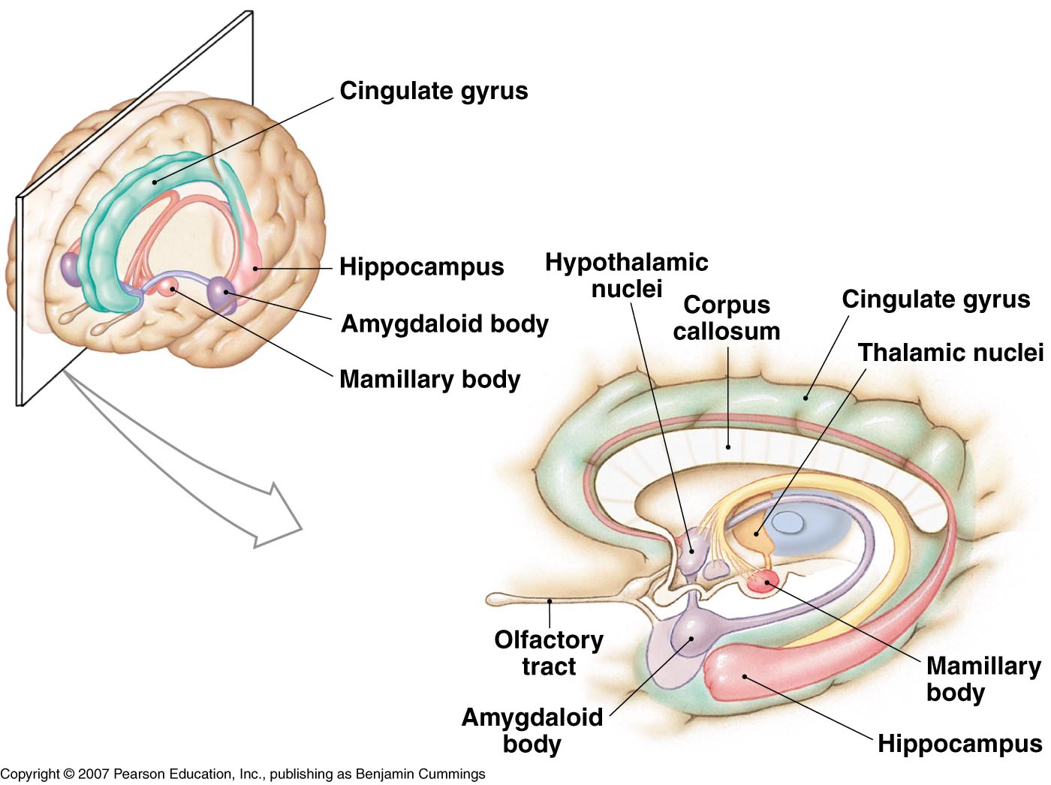
Limbic system
functionally related areas in cerebrum, thalamus & hypothalamus involved in
emotional states & behaviors
linking conscious areas of cerebrum with unconscious areas of brainstem
long term memory

Slide 34
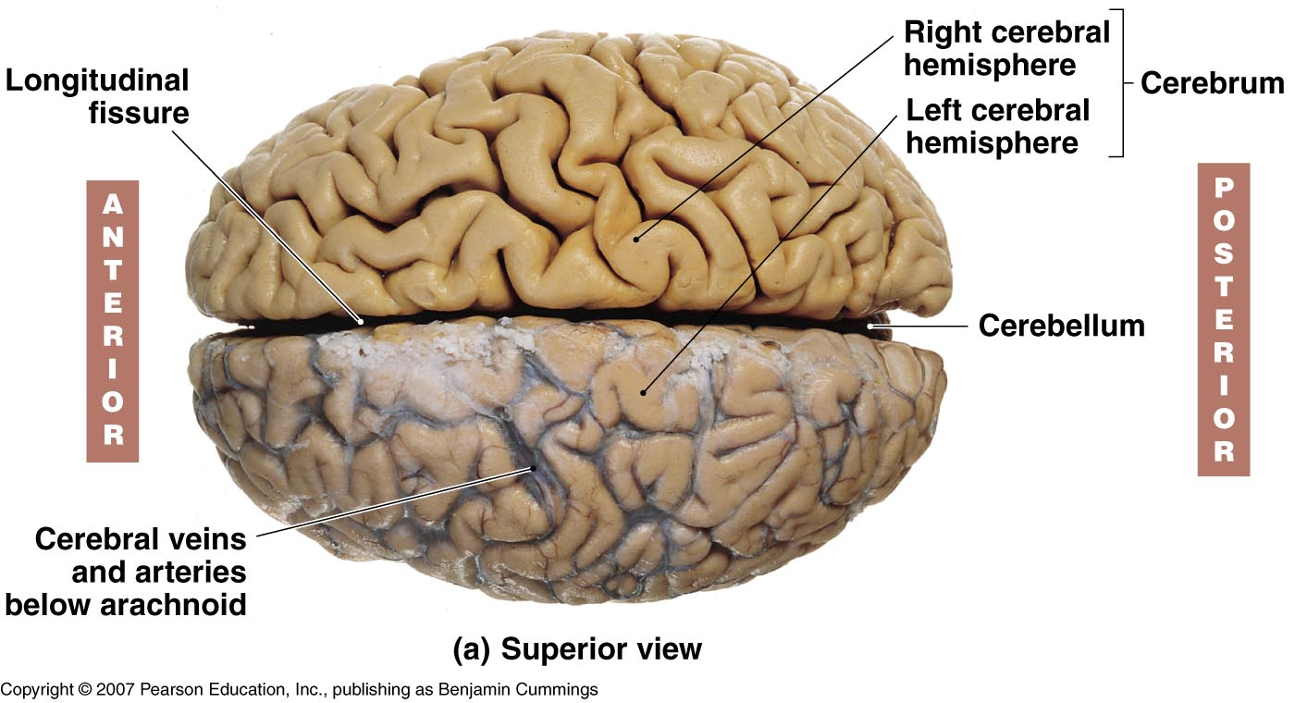
Cerebrum
gyrus
sulcus

Slide 35
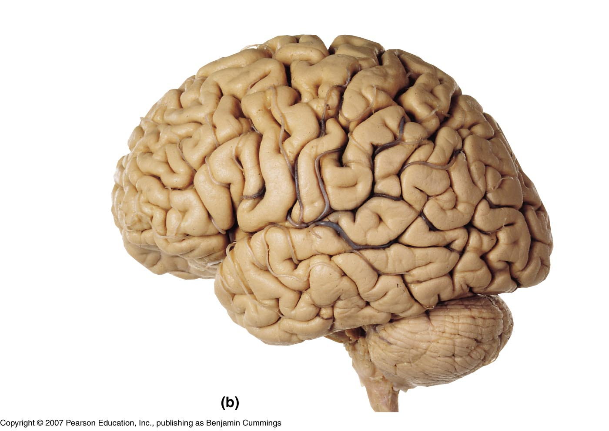
Lobes of Cerebral Hemispheres
Central sulcus
Parietal lobe
Parieto-occipital sulcus
Frontal lobe
Occipital lobe
Lateral sulcus
(Insula is deep to lateral sulcus)
Temporal lobe

Slide 36
insula

Slide 37
Gray & White matter of cerebrum
Gray matter – outer cortex & inner nuclei (centers)
White matter – deep to cortex; comprised of fibers (pathways for communication):
association
commissural
projection

Slide 38
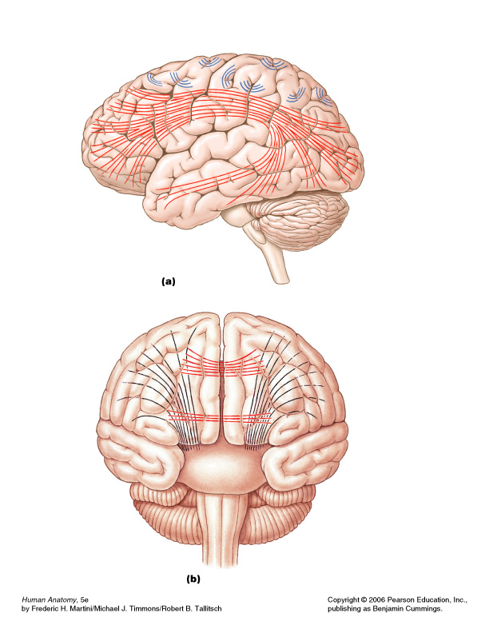
White matter of cerebrum
Association fibers
association fibers – connect gyri in same hemisphere
commissural fibers – connect gyri in opposite hemispheres (e.g. corpus callosum)
projection fibers – connect cerebrum with other parts of brain & spinal cord
Commissural fibers
Projection fibers

Slide 39
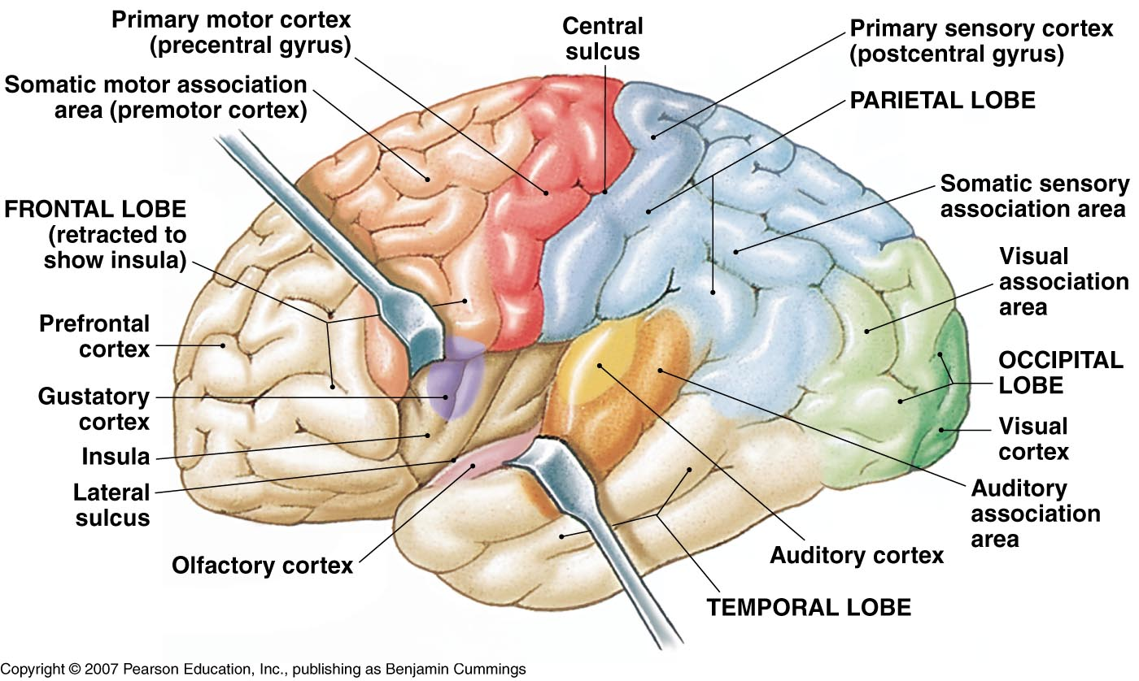
Functional areas of Cerebrum
Motor and Sensory areas - receive sensory info & generate motor (skeletal muscle) responses
Association areas – interpretation of sensory info & planning and coordination of motor responses
Cerebral processing centers - higher order integrative & analytical functions

Slide 40
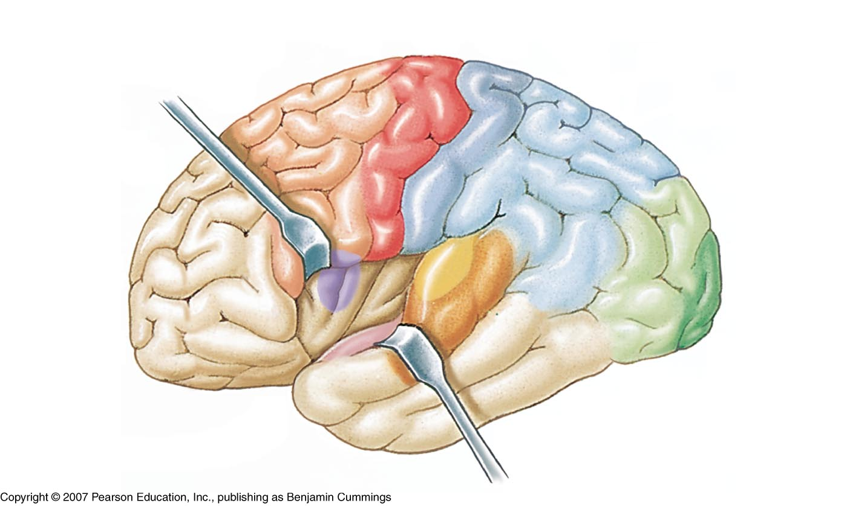
Motor & Sensory
primary motor cortex (precentral gyrus)

Slide 41
Motor & Sensory
primary sensory cortex (postcentral gyrus)

Slide 42
Motor & Sensory
primary motor cortex (precentral gyrus)
primary sensory cortex (postcentral gyrus)
gustatory cortex
visual cortex
auditory cortex
olfactory cortex

Slide 43
Association areas
interpret incoming sensations; coordinate motor responses
somatic motor association area (premotor cortex)
visual association area

Slide 44
Cerebral Processing Centers
higher-order integrative centers
may be unilateral
general interpretive area (gnostic) –Lt hemisphere usually
motor speech center (Broca’s) - Lt hemisphere usually
Prefrontal cortex (bilat.)

Slide 45
The Cerebellum
2 hemispheres connected by vermis
separated from cerebrum by transverse fissure
outer folia with inner arbor vitae
functions include control of skeletal muscles (unconscious) for balance, coordination & posture
Stores patterns of movement
links to brainstem by cerebellar peduncles
transverse fissure
arbor vitae (white matter)
folia (gray matter)

Slide 46
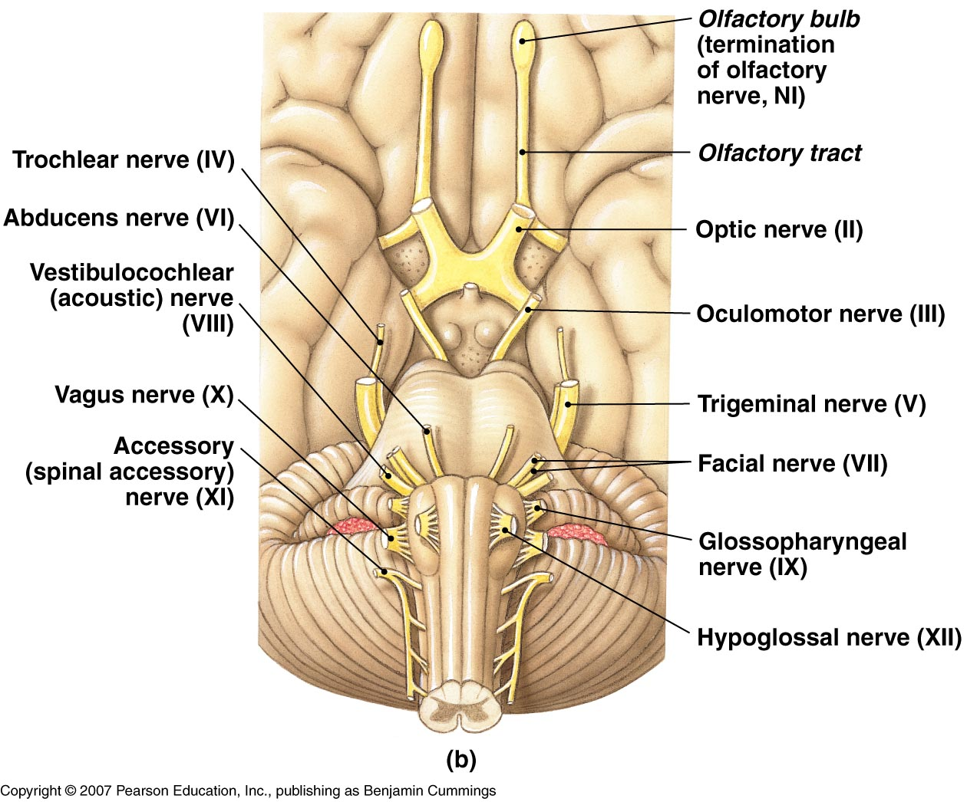
Cranial Nerves
12 pairs of nerves (part of PNS) that connect to the brain; provide motor, sensory &/or autonomic (parasympathetic) function

Slide 47
Cranial Nerves (know #, name & basic function)
I Olfactory – smell
II Optic – sight
III Oculomotor – motor to eye muscles; ANS for accommodation of lens & pupil constriction
IV Trochlear – motor to one eye muscle
V Trigeminal – motor to muscles of mastication, sensation to face & mouth
VI Abducens – motor to one eye muscle
VII Facial – motor to muscles of facial expression; taste; ANS to lacrimal & salivary glands
VIII Vestibulocochlear – equilibrium & hearing
IX Glossopharyngeal – swallowing, taste, ANS to salivary glands, sensory reception from monitoring of blood pressure in large arteries
X Vagus – sensation from viscera; ANS visceral muscle movement (respiratory, digestive, cardiovascular systems)
XI Accessory – motor to muscle of pharynx, SCM & Trapezius
XII Hypoglossal – motor to tongue muscles

