Slide 1
The Nervous System Chapter 8 – The Autonomic Nervous System

Slide 2
Cranial Nerves (know #, name & basic function)
I Olfactory – smell
II Optic – sight
III Oculomotor – motor to eye muscles; ANS for accommodation of lens & pupil constriction
IV Trochlear – motor to one eye muscle
V Trigeminal – motor to muscles of mastication, sensation to face & mouth
VI Abducens – motor to one eye muscle
VII Facial – motor to muscles of facial expression; taste; ANS to lacrimal & salivary glands
VIII Vestibulocochlear – equilibrium & hearing
IX Glossopharyngeal – swallowing, taste, ANS to salivary glands, sensory reception from monitoring of blood pressure in large arteries
X Vagus – sensation from viscera; ANS visceral muscle movement (respiratory, digestive, cardiovascular systems)
XI Accessory – motor to muscle of pharynx, SCM & Trapezius
XII Hypoglossal – motor to tongue muscles

Slide 3
Autonomic Nervous System (ANS)
Motor regulation of smooth muscle, cardiac muscle, glands & adipose tissue (“visceral effectors”) through stimulation of “visceral efferent fibers”
Sympathetic (Σ) division – “fight or flight” response
Parasympathetic (PΣ) division – rest & repose (“conserve & restore”) response
“dual innervation” – if organ receives both Σ & PΣ, one division excites, the other inhibits activity

Slide 4
Overview of ANS anatomy
Somatic efferent:
CNS
Somatic motor neuron
Skeletal muscle
Visceral (autonomic) efferent:
CNS
Preganglionic neuron
Autonomic ganglion
Postganglionic neuron
Visceral effector
(myelinated, cholinergic)
unmyelinated, cholinergic or adrenergic)
(excitatory synapse)
Effect may be excitatory or inhibitory depending on receptors

Slide 5
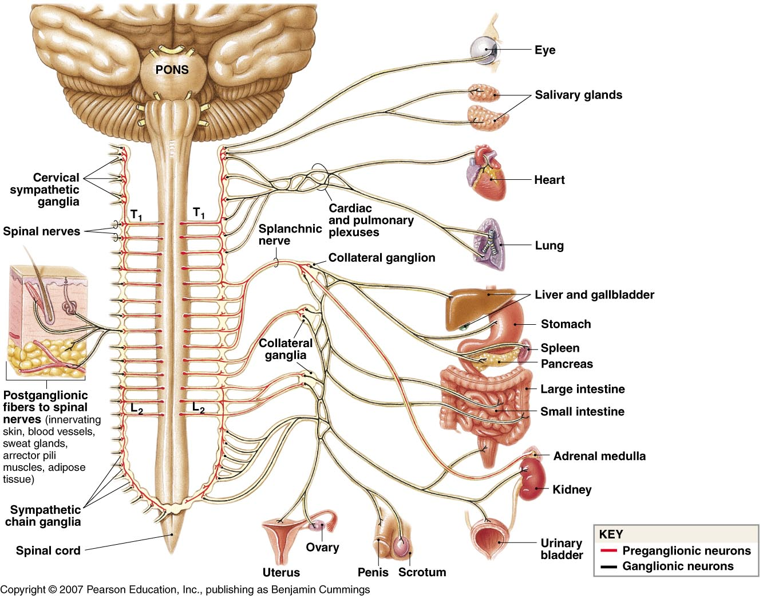
Sympathetic
cell bodies of preganglionic neurons in lateral gray horns of spinal cord T1-L2 (“thoracolumbar division”)
axons of pregg Σ neurons travel to:
sympathetic chain ganglion, or
prevertebral (collateral) ganglion,&
adrenal medulla
pregg Σ fibers release Ach
postgg Σ neurons usually release norepinephrine (NE)
effects on visceral effectors usually excitatory but depend upon specific receptor present - alpha (α) or beta (β)

Slide 6
Sympathetic:
Σ Chain ganglion
Prevertebral ganglion
Lateral gray horns T1-L2
Preganglionic neuron
Visceral effector
Postganglionic neuron
(myelinated, cholinergic)
unmyelinated
NE released (adrenergic)
(excitatory synapse)
Effect may be excitatory or inhibitory depending on receptors
Alpha(α) or beta (β)

Slide 7
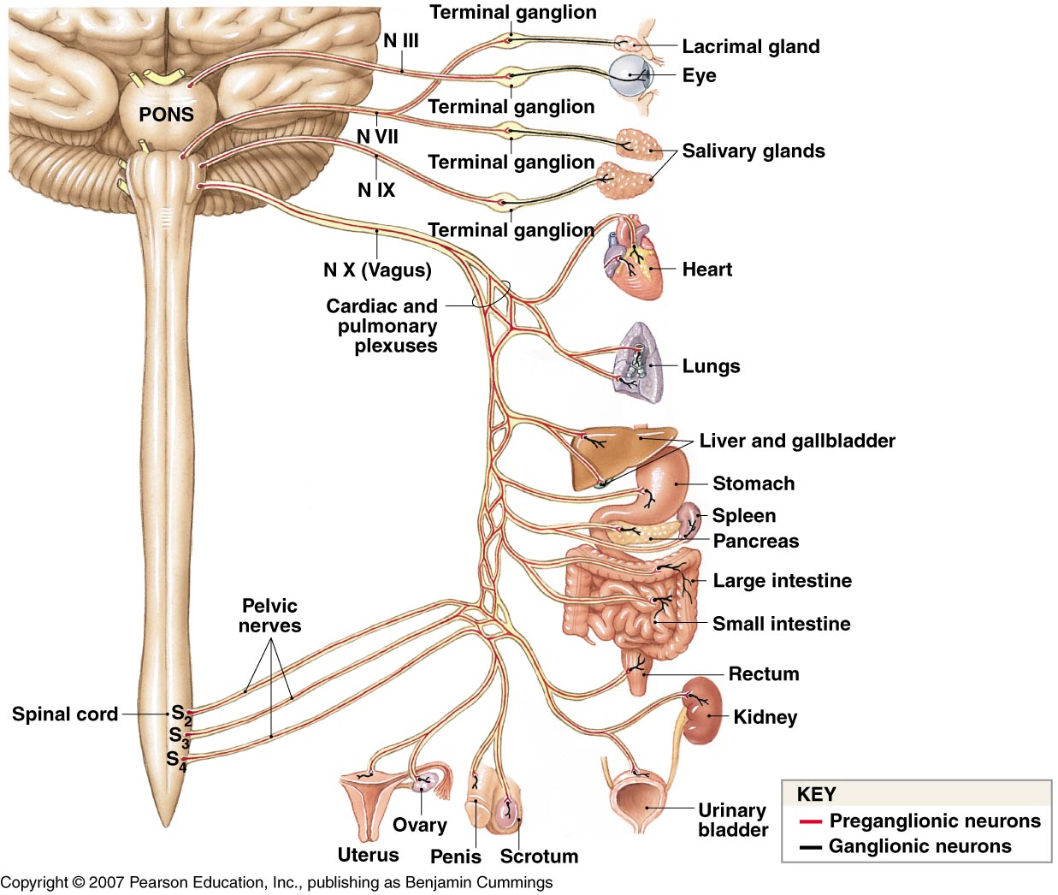
Parasympathetic
cell bodies of preganglionic neurons found in cranial nerve nuclei (III, VII, IX, X) & lateral gray horns S2-S4 (“craniosacral division”)
pregg PΣ neurons travel to terminal ganglion (close to) or intramural ganglion (within wall) of effector
both pre & postganglionic PΣ fibers release Ach
effects on organ depend on specific receptor present (nicotinic or muscarinic)

Slide 8
Parasympathetic:
CNs (III, VII, IX, X) & Lateral gray horns S2-S4
Terminal ganglion
Intramural ganglion
Preganglionic neuron
Visceral effector
Postganglionic neuron
(myelinated, cholinergic)
unmyelinated
Ach released (cholinergic)
(excitatory synapse)
Effect may be excitatory or inhibitory depending on receptors
Nicotinic or Muscarinic

Slide 9
Activities of the ANS
Effects of Sympathetic Activation -“fight or flight” response (energy expenditure):
increased cardiovascular & respiratory activity
increased blood flow to brain (increased alertness), skeletal muscles, heart muscle, lungs
increased visual acuity (pupil dilation)
release of energy reserves from adipose, liver, & skeletal muscles
decrease in “non-essential” functions (ie. digestion)
release of Epi & NE from adrenal medullae to continue effects

Slide 10
Activities of the ANS
Effects of Parasympathetic Activation -“rest & repose” response (conserve & restore energy):
decreased cardiovascular & respiratory activity
increased GI motility & enzyme secretion
pupil constriction
nutrient uptake & energy storage into adipose, liver, & skeletal muscles (glycogen)

